Slide 1
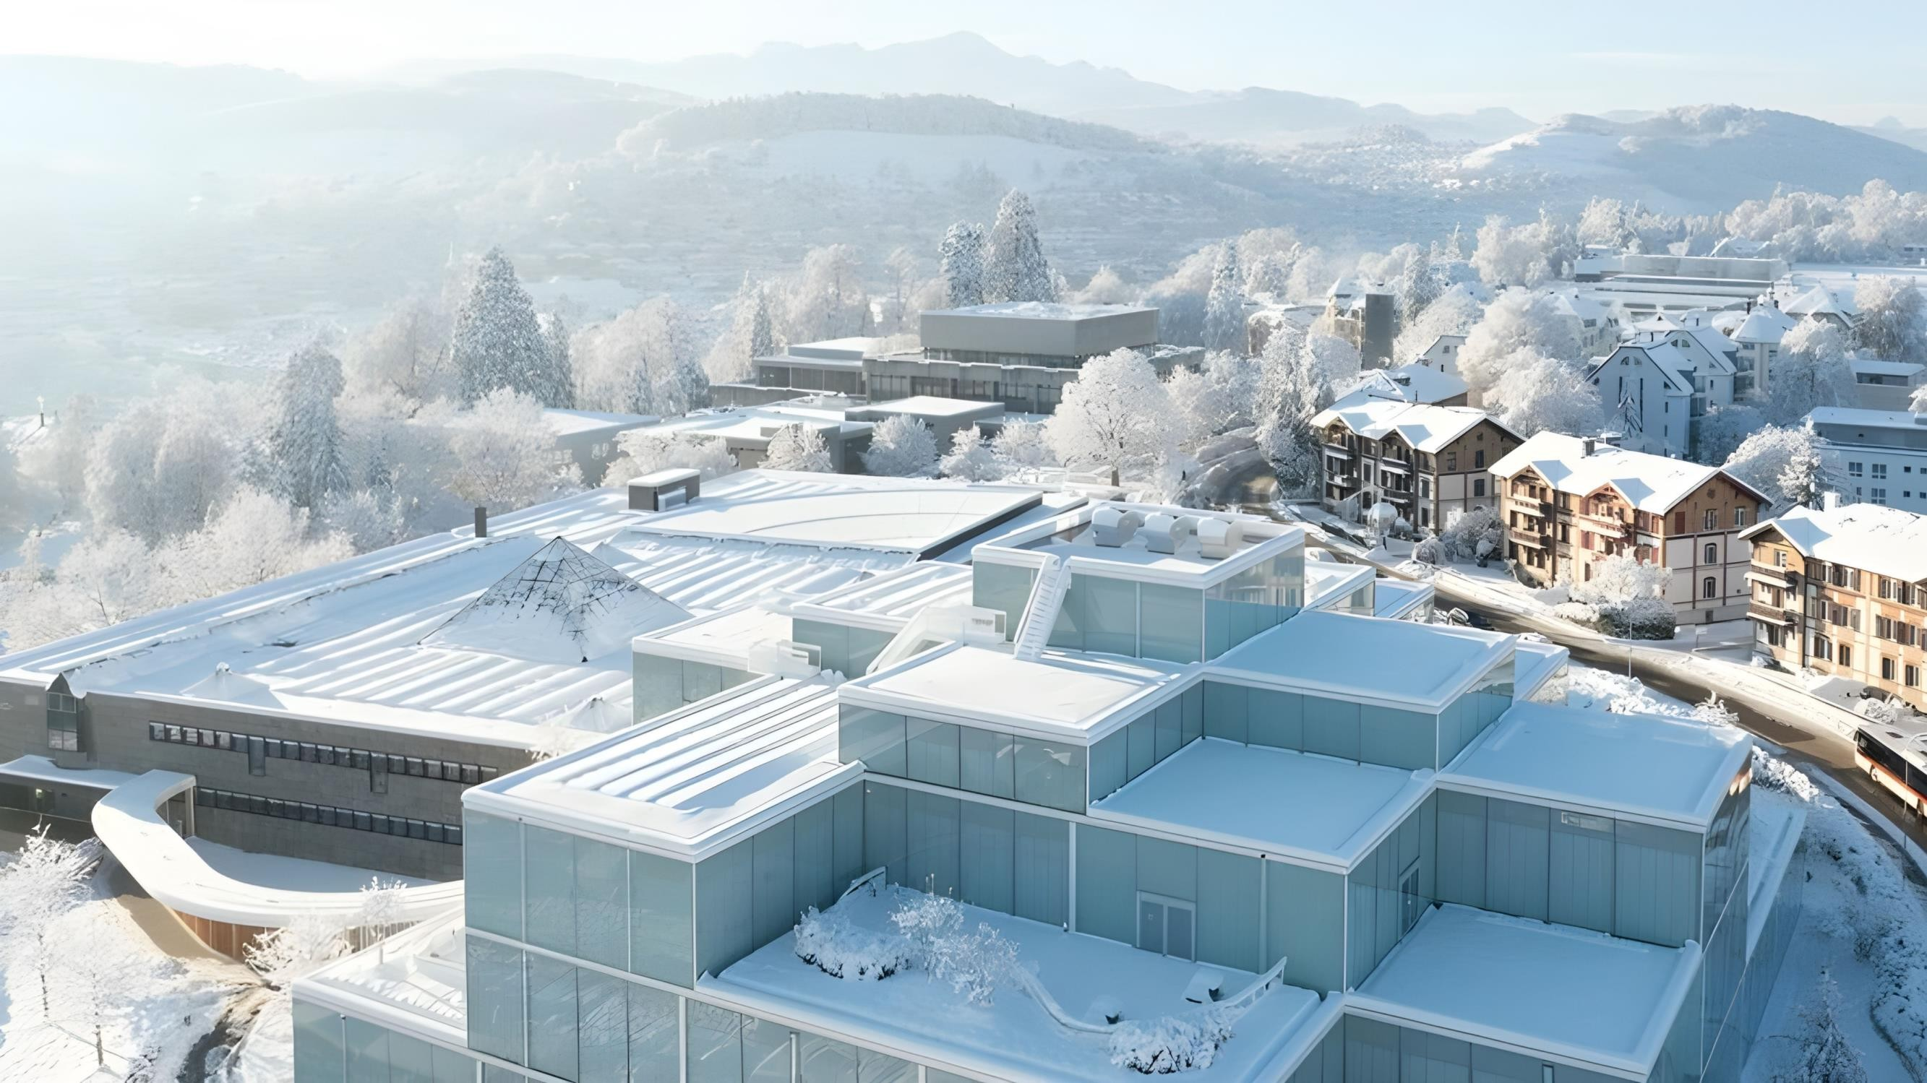
Reaching for the Clouds
Mountains & Accretions
Berit Schrader | Philipp Burkhardt | Ivan Kamenov Otmar Simon Hübscher | Moritz Olbrich University of St. Gallen
St. Gallen, 10th March, 2024

Slide 2
Table of Contents
 | Executive Summary | p. 4
I. | Market Analysis | p. 6
II. | Strategic Fit IBM Equinix Strategic Fit | p. 15
III. | Financial Analysis Comparables Discounted Cash Flow Synergies | p. 31
IV. | Feasibility | p. 49
V. | Alternative Solution | p. 55
VI. | Conclusion | p. 66
 | Appendix
 | Bibliography
2

Slide 3
Table of Abbreviations
Abbreviation | Explanation
AFFO | Adjusted Funds From Operations
AI | Artificial Intelligence
APAC | Asia Pacific
Avg | Average
bn | Billion
C&IP | Consumer & Industrial Products
CAGR | Compound Annual Growth Rate
Capex | Capital expenditures
CEO | Chief Executive Officer
CO | Cyrius One
DCF | Discounted Cash Flow
DB | Digital Bridge
E | Estimates
e.g. | exempli gratia (for example)
E&R | Energy & Resources
EBIT | Earnings Before Interest and Taxes
EBITDA | Earnings Before Interest, Taxes, Depreciation, and Amortization
EPS | Earnings per share
EV | Enterprise Value
FCFF | Free Cash Flow to the Firm
FFO | Funds From Operations
FG 500 | Fortune Global 500
FSI | Financial Services Industry
FX | Foreign Exchange
FY | Fiscal Year
Gen AI | Generative Artificial Intelligence
HHI | Herfindahl-Hirschman Index
IoT | Internet of Things
IP | Intellectual-Property
iPaaS | Integration Platform-as-a-Service
k | thousand
KW | Kilowatt
LBO | Leveraged Buyout
lbs | pounds
LSHC | Life Sciences and Health Care
Abbreviation | Explanation
LTM | Last Twelve Months
m | million
M&A | Mergers & Acquisitions
MLSE | Maximum Likelihood Sequence Estimation
MRR | Monthly Recurring Revenue
MW | Megawatt
n.a. | not available
NAV | Net Asset Value
nm | nanometer
n.m. | not meaningful
NOI | Net Operating Income
NOLs | Net Operating Losses Carryforwards
NWC | Net Working Capital
NYC | New York City
P | Price
p.a. | per annum
PoP | Point of Presence
R&D | Research and Development
RE | Real Estate
REIT | Real Estate Investment Trust
SBC | Stock-Based Compensation
SF | San Francisco
SG&A | Selling, General & Administrative
TAM | Total Addressable Market
TMT | Telco, Media and Technology
UPREIT | Umbrella Partnership Real Estate Investment Trust
US | United States
USD | United States Dollar
WACC | Weighted Average Cost of Capital
Y | Year
yrs | years
YTD | Year to Date
3

Slide 4
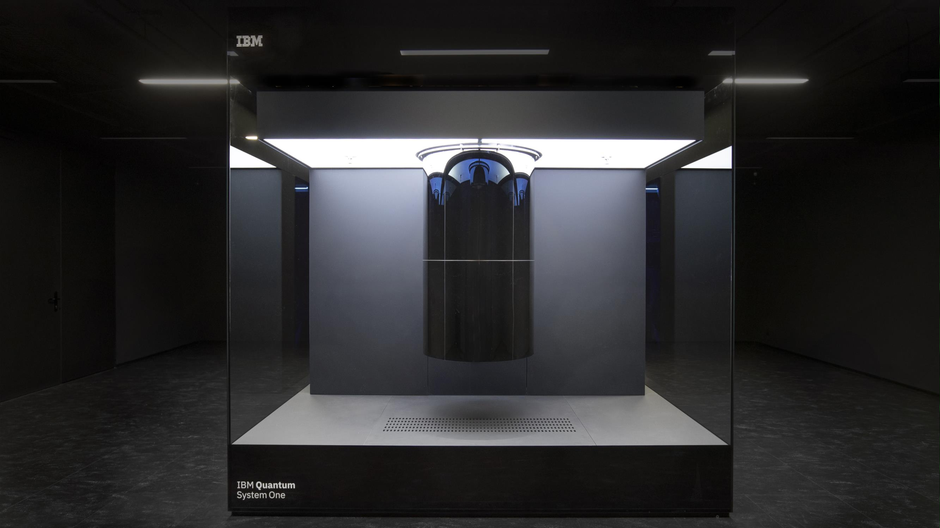
EXECUTIVE SUMMARY
Towards the Future

Slide 5






Executive Summary
IBM should not buy Equinix but acquire leading cybersecurity company Rapid7 to expand its footprint in the digital infrastructure and Cloud sector
Equinix is a real estate investment trust that operates
data centers focusing on colocation and interconnection
IBM as a software company has little strategic fit with operating the physical data center infrastructure
At a market valuation of $ 95.9bn EV, Equinix is
overvalued 48% by Net Asset Value and 64% by DCF
Even with synergies of $ 12.2bn, acquiring Equinix at a
15% premium would still destroy shareholder value
Given the transaction size of $ 107.9bn, a cash deal is
not feasible as inordinate debt issuance is needed
Due to Equinix’ tax status as a REIT, a merger is not advisable. Post-merger integration is likely challenging
Rapid7 is a market leader in cyber security solutions for digital infrastructure with a focus on cloud security
Great strategic fit with IBM’s existing cybersecurity solutions due to complementary cloud security focus
Rapid7 is priced fairly at a market valuation of $ 3.9bn EV
and there is 19% valuation upside to IBM after synergies
Synergies of $ 1.2bn from cross-selling and cost savings sweeten the deal beyond strategic rationale
IBM’s usual deal sizes have not exceeded $ 5bn and
used cash-on-hand, which are both possible for Rapid7
IBM and Rapid7 have a shared culture of open source
support and post-merger-integration is likely to succeed
IBM should NOT AQUIRE Equinix
IBM should instead ACQUIRE Rapid7
Executive |  | Market Analysis |  | Strategic Fit |  | Financial |  | Feasibility |  | Alternative |  | Conclusion
Summary |  |  |  |  |  | Analysis |  |  |  | Solution
5

Slide 6
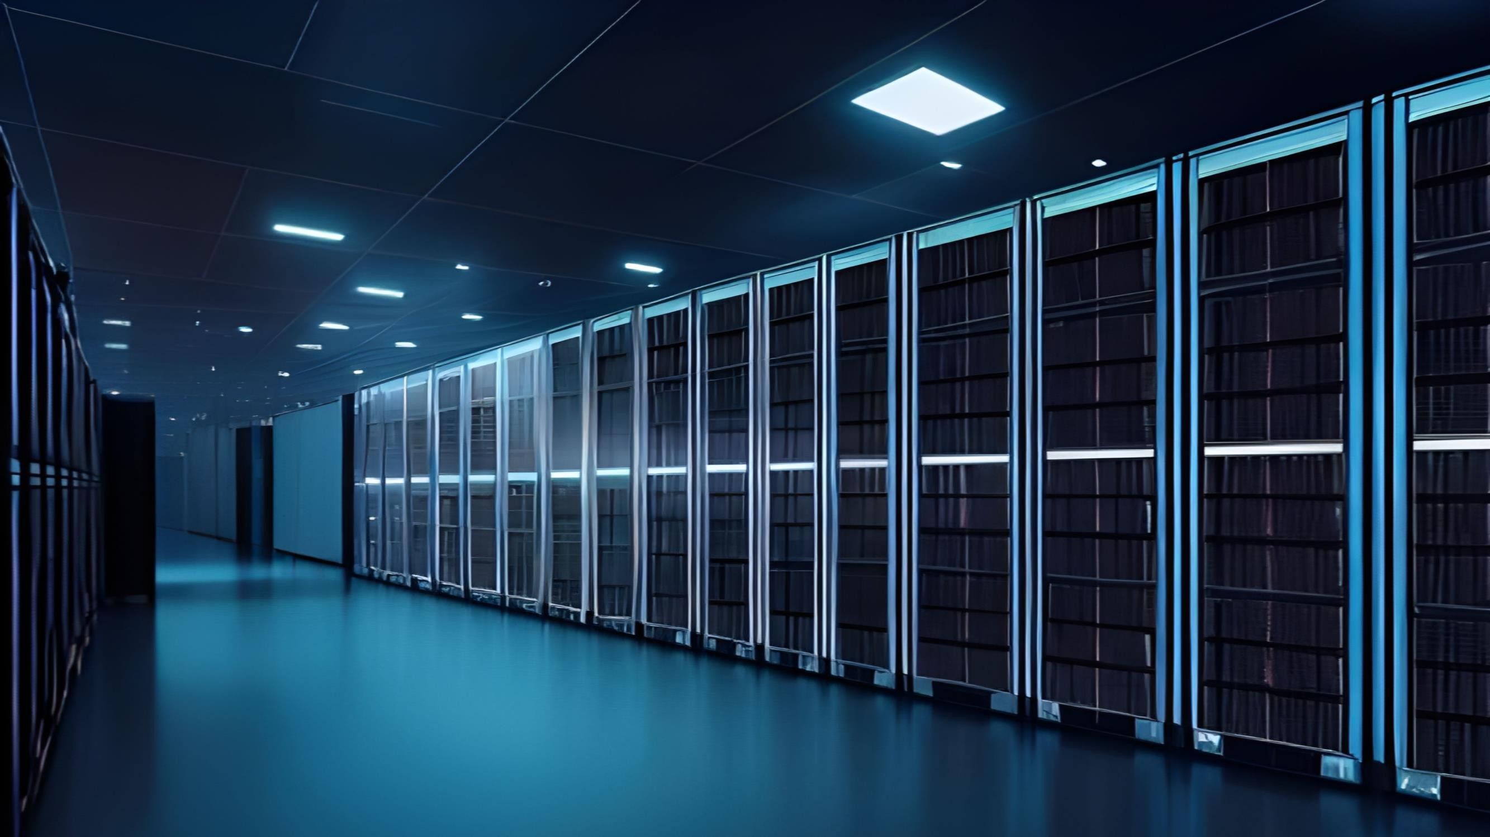
MARKET ANALYSIS
Data is the New Oil

Slide 7

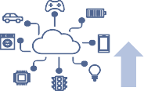
Makeup of the Digital Infrastructure and the Cloud Sector
AI and IoT are built upon Cloud architectures, which need the infrastructure of data centers and cybersecurity solutions
Artificial Intelligence (AI) Internet-of-Things (IoT)
10% - 25%
of labor projected to
be automated by AI
36.6%
2030 CAGR
Peak AI hype
9.96%
2030 CAGR
$ 4.4m
Average cost of a data breach
AI will revolutionise industries but is at the peak of the hype cycle
The internet of things is growing fast and loose, lacking cybersecurity
Digital Cloud Infrastructure
Data Centers
Data centers are the physical backbone of the Cloud and house the hardware
Data center operations include
interconnection and colocation
Cybersecurity Solutions
Cybersecurity solutions ensure the physical and digital safety of the Cloud
Cybersecurity solutions include data
integrity and penetration testing
&
Source: Grimond, L., Beyer, M. and Maguire, A., 2023), (Kolesnikov, N., 2023), (Statista, 2024b)
Executive |  | Market Analysis |  | Strategic Fit |  | Financial |  | Feasibility |  | Alternative |  | Conclusion
Summary |  |  |  |  |  | Analysis |  |  |  | Solution
7

Slide 8



Foundations of the Economy of Tomorrow
Supporting technologies of the digital infrastructure represent significant commercial opportunities
Secular trends shaping the economy of tomorrow
Industry-specific tech will be shaped by industry-agnostic supporting tech
Cognitive Automation
Large parts of repetitive, pattern-based intellectual work is automated as AI finds industrial usage, largely boosting productivity and changing tertiary work.
Industry- Specific Trends (Examples)
Sustainable Construction Infrastructure
Manufacturing
Automation
Longevity & Precision Healthcare
Mobility & Renewable
Transportation
Space
Technology
Retail
Personalization
Advanced Connectivity
The flow of data between objects and people increases exponentially as industrial
and human systems become increasingly interconnected and online.
Applied & Industrial AI
Protectionism & Security
Social tensions and international conflicts will lead to a greater affinity for personal privacy and national security as countries re-shore vital industries and restrict trade.
„Supporting“
Technologies
Cybersecurity & Digital Identity
Edge & Cloud-Based Computing
Electrification & Power Generation
...
The development and maintenance of “supporting” echnologies represents a high-growth opportunity
Comparing Fundamental Technologies |  | 10Y CAGR | T+10 TAM
 | Applied AI | 25-40% | Very High Highly Viable ^{Market} Applied AI _{Cloud} Opportunties
 | Cloud-Services | 10-20% | ^{High} Renewables ^{Computing}
Software Layer | IoT / Networking (Software) | 10-25% | Chip ^{High} Manufacturing IoT / Cybersecurity
 | Cybersecurity & Digital Identity | 15-30% | High Data Centers _{Networking}
 | Electification & Power Gen. | 5-15% | Commercial _{(Hardware)} ^{Very High} Viability:
 |  |  | ^{next 10} Medical AI Quantum _{years} Web3 & Blockchain _{Computing}
 | Chip Manufacturing | 5-10% | Very High Immersive Carbon Capture
 | Cloud-Infra (Hardware) | 10-15% | High Reality Tech Tech _{Space}
Hardware Layer | IoT / Networking (Hardware) | 5-15% | _{Med} Mobility Services _{Bioengineering} Manufacturing
 | Quantum Computing | 5-50% | Low - High ^{Fusion} Unviable; ^{Excitement} High Medium Low ^{Technology}
 | Mobility Services | 5-10% | ^{High} Nascent ^{Factor}
Source: ((Fortune Business Insights, 2023), (Exploding Topics, 2022), (Charles, A., 2023), (Lambert Consulting, 2023)
Highly Crowded
Market Openness
Highly Open; Uncompetitive
Executive |  | Market Analysis |  | Strategic Fit |  | Financial |  | Feasibility |  | Alternative |  | Conclusion
Summary |  |  |  |  |  | Analysis |  |  |  | Solution
8

Slide 9








Introduction to the Cloud Market
The market for Cloud applications is fueling the demand for data center support infrastructure
In the tri-layered Cloud composition SaaS is the largest market
There are three main Cloud models: Private, Public, and Hybrid
Software as a Service (SaaS)
Especially interesting for private users is Cloud-based application software complete with user interface
Biggest market
The SaaS market, valued at nearly $200 billion in 2023, is expected to grow at a CAGR of 18% through 2023, marking it as the largest segment in Cloud computing
Private Cloud
Private Cloud uses dedicated infrastructure for enhanced control and improved resource management
Ideal for handling sensitive data, avoiding public Cloud's security and regulatory issues
Public Cloud
Public Cloud offers shared infrastructure for cost efficiency and scalability
Suitable for general workloads with less regulatory and security constraints
Hybrid Cloud
Hybrid Cloud combines public and private Clouds for flexibility and optimized resource use
Ideal for balancing sensitive data handling with cost- effective scalability
Product as a Service (PaaS)
Providers deal administration of servers and rent out predefined platforms for software development
Smallest segment
In 2023, the PaaS market was valued at $60.26 billion, making it the smallest of the three main Cloud computing segments
Infrastructure as a Service (IaaS)
Providers rent out storage and computing capacities on their servers.
Growth
With a CAGR of 20.3% until 2030 the IaaS market is expected to grow the fastest
….. .….
Long-term trends are transforming the Cloud market…
…positively impacting an array of different industries
Expected 2030 EBITDA run-rate impact ($ bn)
Artificial Intelligence Integrating AI solutions into Cloud infrastructure, aims to increase efficiency by managing and
automating internal processes smartly
Ongoing Migration
Over 60% of enterprises are adopting Cloud solutions to drive their business transformation, a trend expected to continue and expand
High Tech Oil & Gas
Retail
Healthcare Insurance
Banking
Automotive
Telecom Advanced electronics
Consumer goods
Transport & logistics Phramaseuticals Media & entertainment
Travel
110 - 160
80 - 160
90 - 140
70 - 140
60 - 80
70 - 110
40 - 60
40 - 60
Edge Computing
The transition towards edge computing will significantly
decreasing latency, consequently
improving data transmission
Multi and Hybrid Cloud
Currently, 80% of businesses use hybrid Cloud solutions, a 38% increase from 2019, indicating high ongoing demand
30 - 50
20 - 40
20 - 40
20 - 40
20 - 30
10 - 30
Source: (Grimond, L., Beyer, M. and Maguire, A., 2023), (Kolesnikov, N., 2023), (Statista, 2024b), (The Business Research Company, 2024), (Fortune Business Insights, 2023), (Exploding Topics, 2022), (Charles, A., 2023),
(Lambert Consulting, 2023)
Executive |  | Market Analysis |  | Strategic Fit |  | Financial |  | Feasibility |  | Alternative |  | Conclusion
Summary |  |  |  |  |  | Analysis |  |  |  | Solution
9

Slide 10
Drivers and risks of Cloud adoption
Cloud computing adoption will increase out of necessity, but there are major risks
Surging data demand drives significant Cloud market growth
Tailwinds from heavy reliance on distributed systems
Data Generated (Zettabytes) and Projected Cloud Market Size ($ bn)
The usage of data and compute resources displays high daily seasonality – distributed systems and public Cloud computing allow the allocation of resources only when they are needed, slashing costs.
+50.8%
181
1,589
+17.0%
1,355
1,156
Same Required
Initial
Investment
120
844
987
618
722
454
530
Compute / Data
Requirements
9:00
17:00
9:00
9:00 17:00 9:00
Region A Region B
17:00
Region C
17:00
2022 2023 2024E 2025E 2026E 2027E 2028E 2029E 2030E
Region A
2023 2025E
Firms adopt hybrid Clouds from multiple vendors Cloud provider concentration carries major risks
Sensitive Cloud data increases cyber attack risk
75% 39%
80% 89%
Wide Incident
Due to market concentration, a single provider’s Cloud issues could have widespread, significant impacts
2/3
Of the Cloud market is controlled by three firms
Of companies use a hybrid Cloud approach utilizing public and private Clouds
Of Companies use a Multi-Cloud approach, utilizing Clouds from more than one provider
High Vendor Dependence
Market concentration increases customer dependency, reducing bargaining power and risking vendor lock-in with fewer providers
Of companies say 40% or more of their Cloud data is sensitive
(58% in 2022)
Of Companies have experienced data breaches in their Cloud environment (35% in 2022)
Source: (Grimond, L., Beyer, M. and Maguire, A., 2023), (Statista., (2023a, 2023b)), (MarketsandMarkets, 2023), (Precedence Research, 2023), (Duarte, F., 2023), (Richter, F., 2023), (Thales, 2023)
Executive |  | Market Analysis |  | Strategic Fit |  | Financial |  | Feasibility |  | Alternative |  | Conclusion
Summary |  |  |  |  |  | Analysis |  |  |  | Solution
10

Slide 11
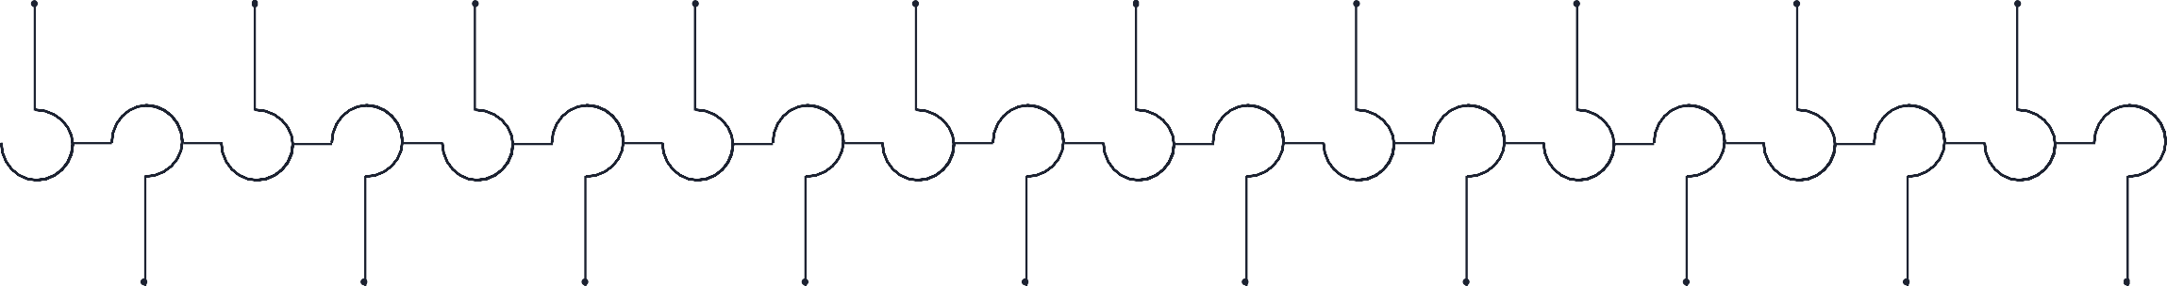










Overview and Potential of Artificial Intelligence
Due to significant interest and diverse applications, AI is poised to revolutionize industries, potentially growing to a nearly $2 trillion market by 2023
With increasing investments…
… and huge automation potential…
25% 10-20%
…the AI market is bound to grow substantially
Private AI investments in $ bn
Global AI Revenue forecast ($ m) with Gen AI's share
160
140
120
100
80
60
40
20
0
World US China
1,847,496
1,415,055
CAGR 36.6%
1,068,718
Of advanced economies, labor tasks projected to be automated by AI
Of emerging economies, labor tasks projected to be automated by AI
795,385
582,949
298,247
207,902
18.6% 21.8%
420,466
28.0%
95,603
142,320
26.8%
27.6%
4.9%
23.9%
25.8%
17.2%
24.7%
2019 2020 2021 2022 2023E 2024E 2025E 2021 2022 2023 2024E 2025E 2026E 2027E
The AI market has continuously evolved over the past two decades, introducing numerous groundbreaking applications
2028E 2029E 2030E
2009 | 2011 |  | 2012 | 2014 | 2016 | 2017 | 2018 |  | 2020 | 2021 | 2022
Google begins |  | IBM’S Watson | Large neural network | Chatbot “Eugene” | Introduction of | Training chatbots for |  | Google Duplex, Ai | Introduction of Open | Introduction of |  | Introduction of
developing driverless |  | computer wins | training to recognize | convinced judges to | Sophia, a robot that | human-like |  | assistant that books | AI’s Chat GPT 3 | LaMDA, a large |  | Stable “Diffusion”,
cars |  | Jeopardy game | cat images | be a human | can "see" and | interaction and mutual |  | appointments via | language model | language model for |  | a text-to-image
 |  | show |  |  | express facially | communication |  | phone |  | human-like responses |  | AI
Launch of first gaming device tracking human
movement
2010
Introduction of Siri, a voice assistant
Introduction of a
virtual assistant
Introduction of
the virtual assistant Alexa
AlphaGo, a computer program, beats Go world
champion
2016
Alibaba AI outperforms humans in Stanford
test
2018
Introduction of T-NLG, largest language model
at the time
2020
Unveiling of OpenAI’s DALL-E,
an image-creation
AI
2021
Public debut of
ChatGPT
Unveiling of Bard, Alphabet’s generative AI tool
2011 2012 2014
2022
2023
Source: (Thormundsson, B., 2023), (Statista, (2024a, 2024b, 2024c)), (Nathan, A., Grimberg, J., Rhodes, A., 2023), (Solberg, T.L., 2023), (Goldman Sachs, 2023)
Executive |  | Market Analysis |  | Strategic Fit |  | Financial |  | Feasibility |  | Alternative |  | Conclusion
Summary |  |  |  |  |  | Analysis |  |  |  | Solution
11

Slide 12
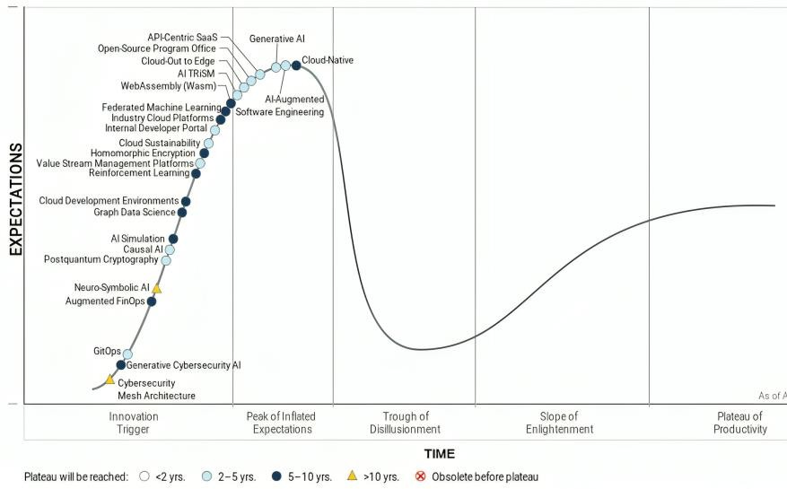
Challenges of Artificial Intelligence
Nevertheless, the AI hype underemphasizes its current flaws and the importance of supporting functions for AI
Gen AI is leading the Gartner Hype Cycle
AI startup valuations surged tremendously…
…heavily benefiting the market leaders
Expectations for emerging technologies
Median Valuations of Global AI and Non-AI Startups
Revenue Multiples for Leading AI Startups vs. SaaS
Market Average
by Stage ($ m)
+59.2%
120x
112.5x
189
70x 60x 50x 40x 30x 20x 10x 0x
69.3x
73.7x
Non-AI AI
61.5x
+38.8%
119
40.7x
+20.8%
70
21.6x
22.6x
24.6x
50
7.9x
15
19
Seed Series A Series B
Anthropic Stability Databricks Gong OpenAl Perplexity Harvey Hugging Al AI Face
Increasing cybersecurity events
A highly consolidated market
Inaccuracy and cybersecurity are AI‘s biggest risks
Gen AI market share by vendors 2023
% organizations considers risk relevant
95%
15,3%
Inaccuracy
Cybersecurity
56%
75%
Of security professionals witnessed an increase in cyber attacks in 2023
0.7%
53%
39,0%
7,0%
IP infringement
Regulatory
compliance
Explainability
46%
8,0%
45%
39%
39%
Privacy
labor displacement
95% accuracy is often reported for AI programs, but true effectiveness is lower since they can't validate data accuracy, typically staying above 80%
85%
Of these were attributing this rise to generative AI
30,0%
34%
Open AI Microsoft
AWS
Google
IBM
Other
Equity and fairness Organizational
reputation
31%
29%
Source: (Gartner, 2023), (Statista, 2023a), (Finro Financial Consulting, 2023), (Hao, K., 2019), (Deep instinct, 2023), (Mok, A., 2023), (Gianni,P. and Maria, G., 2024), (Drapkin, A., 2023)
Executive |  | Market Analysis |  | Strategic Fit |  | Financial |  | Feasibility |  | Alternative |  | Conclusion
Summary |  |  |  |  |  | Analysis |  |  |  | Solution
12

Slide 13
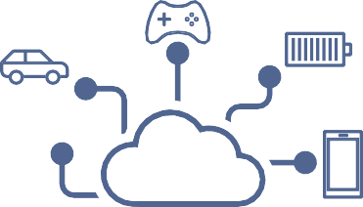






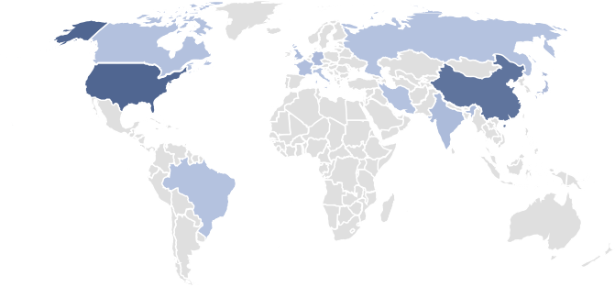
Overview to the Internet of Things
Increased connectivity amongst devices will accelerate Cloud demand
Internet of Things connects interacting devices in one network
Four key trends indicate a 94.4% surge in IoT-connected devices by 2030
Definition
IoT connects physical objects with embedded sensors, software, and connectivity to collect and exchange data, ranging from household items to industrial tools
Applications
Connectivity
IoT market trends and total number of IoT connected devices in million by 2030
These devices communicate with each other and the internet, facilitating autonomous data exchange and actions across
various environments like homes and cities
AI integration in IoT leads to smarter, data-driven decisions and enhanced predictive analytics, boosting operational efficiency
CAGR 9.96%
Enhanced connectivity in IoT facilitates seamless data exchange and inter-device communication, optimizing network performance
29,422
Challenges
Increased automation in IoT streamlines processes and reduces manual intervention, elevating productivity and consistency
15,138
IoT enhances global efficiency and operations with advanced solutions like energy management and supply chain optimization, promoting better resource use and streamlined processes
Successful IoT implementation involves tackling issues like data security, device interoperability, and complex data management, necessitating strategic planning and robust security
Edge computing in IoT brings data processing closer to the source, reducing latency and enhancing real-time decision-making
2023 2030E
US leads the market, with growth of revenues outpacing devices
IoT device cyber attacks rise, averaging $4.45m costs per breach
IoT revenue by region and projections through 2030 ($ bn)
Percent of companies with weekly attacks in first two months of the year
+112.0%
70
Europe
APAC
621,6
60
50
Latin America North America Africa
$ 4.45 m
40
293,2
30
20
10
Average cost of
a data breach¹
#1 USA #2 China #3 Japan #4 Germany #5 India
Note: ¹ Not including reputational or future income damage
2023 2030E
0
2021
2022
2023
Source: (IBM, n.d.a), (ComputerWeekly.de, 2024), (Antino, 2024), (Statista, 2023f), (Check Point research, 2023), (Petrosyan, A, 2024)
Executive |  | Market Analysis |  | Strategic Fit |  | Financial |  | Feasibility |  | Alternative |  | Conclusion
Summary |  |  |  |  |  | Analysis |  |  |  | Solution
13

Slide 14
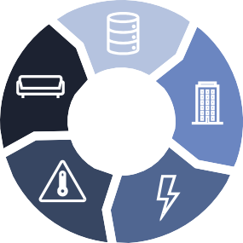
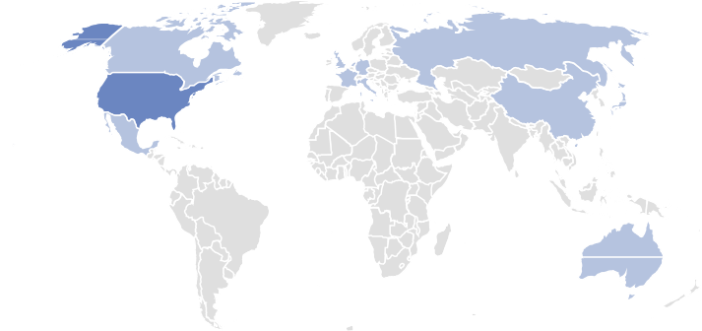










Overview of Colocation and Data Centers
Data centers and colocation play a vital role in enabling Cloud
A data center requires five components for full functionality
Setting up a single data center can cost up to $353m
Servers
The core component, the servers, are often provided by clients in a colocation setup, rather than by the facility operator
Cost by segment and approximately cost calculation
22,5%
17,5%
9‘000 USD per MW
1’800 KW per server
Building Fit Out
Other necessary elements include the lobby, entrance, meeting rooms and the shipping and receiving area
Land & Shell
30 MW
The land is needed for constructing the data center's foundational structure and supporting its critical infrastructure
17,5%
30 MW
42,5%
=
5’000 USD per server
=
HVAC
Heating, ventilation, and air conditioning guarantee optimal airflow management and security measures
Electrical Systems
Land & Shell
Electrical Systems
HVAC
Building Fit-Out
270‘000 facility costs
83’000’000 server
costs
Electrical systems like, detail backup generators, batteries, PDUs, UPS, and switchgear ensure uninterrupted power supply
~ $353m is required for a fully equipped, mid-sized data center ¹
US and Europe lead in data center locations and Equinix the market
Data centers haver been popular acquisition targets in the past
2020 2021 2021 2022 2022 2023
13%
11%
6%
Digital Realty acquired Interxion to enhance its global network and expand its European footprint
Blackstone acquired QTS to expand its infrastructure portfolio and data center market presence
American Tower acquired CoreSite to enhance its position in the data center industry
KKR & GP
acquired
CyrusOne to expand their digital infrastructure investments
Digital Realty acquired Switch Inc. to strengthen its data center portfolio and expand its technological and geographic reach
Brookfield acquired Compass Data centers to enhance its technology infrastructure portfolio
#1 USA #2 Germany #3 United Kingdom #4 China #5 Canada
Note: ¹ Values are derived from average estimates for a medium-sized data center equipped with standard servers; actual costs and allocations may vary on a case-by-case basis
Source: (Statista, 2023c), (Zhang, M.,2022), (Josh Mahan, 2023), (Miinnix, J., 2023), (Vardhman, J., 2024), (Cloudscene, 2023)
Executive |  | Market Analysis |  | Strategic Fit |  | Financial |  | Feasibility |  | Alternative |  | Conclusion
Summary |  |  |  |  |  | Analysis |  |  |  | Solution
14

Slide 15
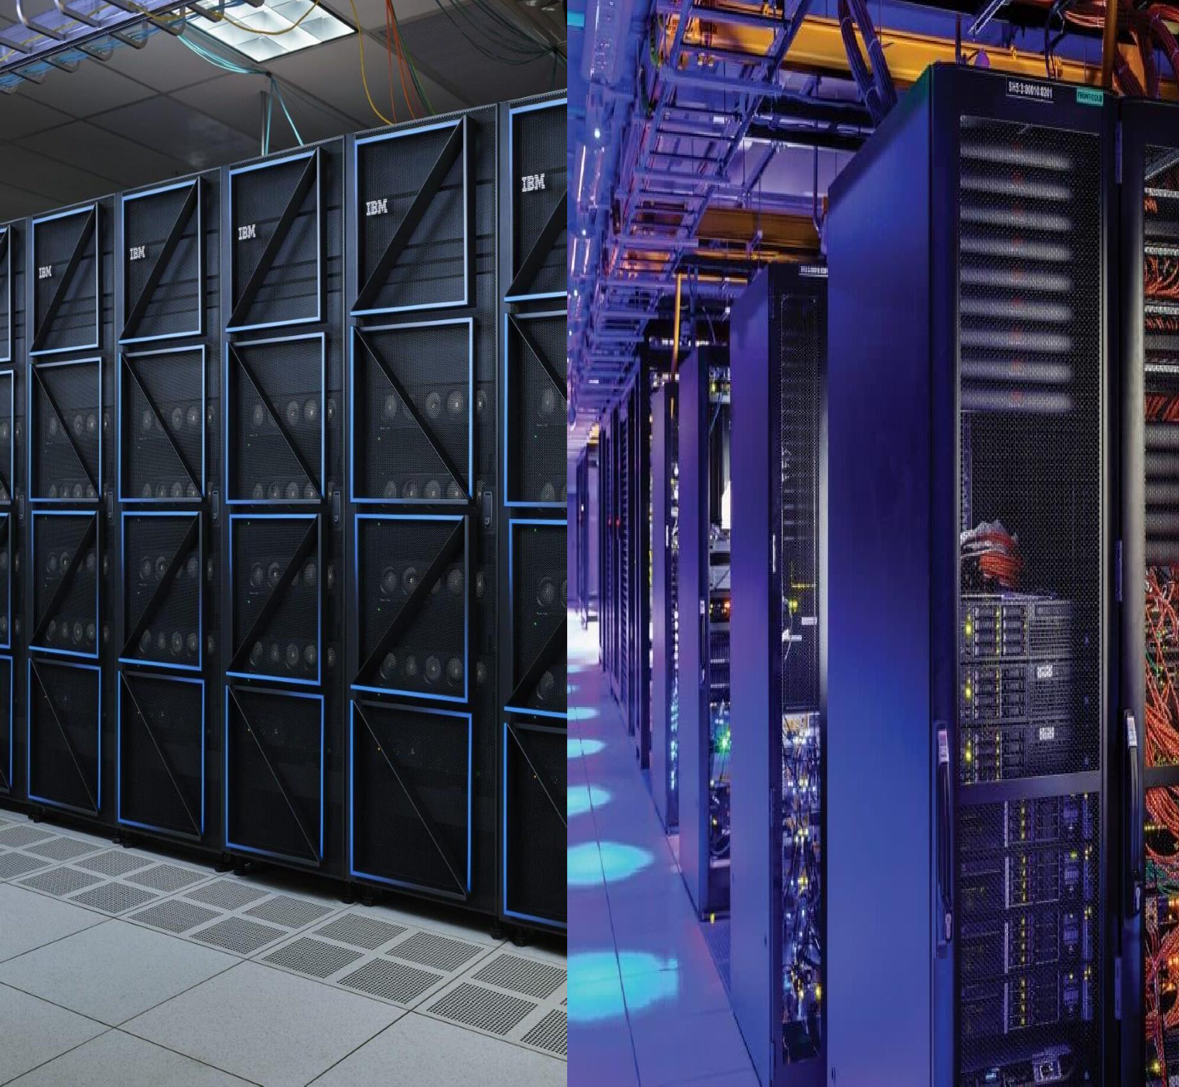
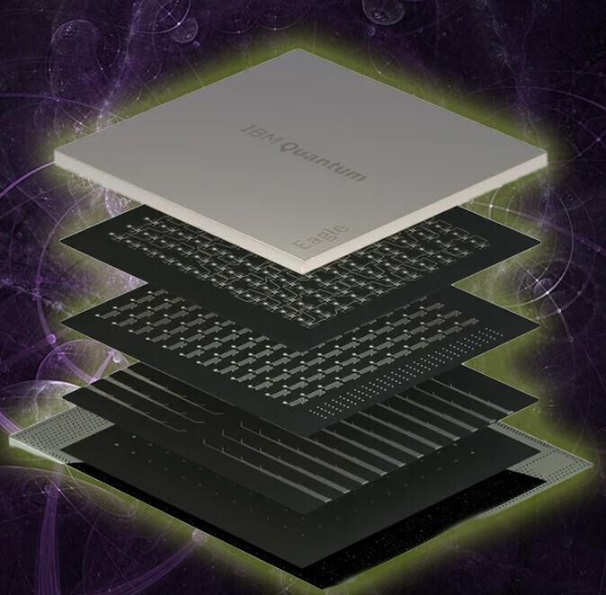
STRATEGIC FIT
IBM
Equinix
STRATEGIC FIT
The Brain
The Fuel
The Machine

Slide 16
STRATEGIC FIT
IBM
The Brain
The Fuel
The Machine

Slide 17

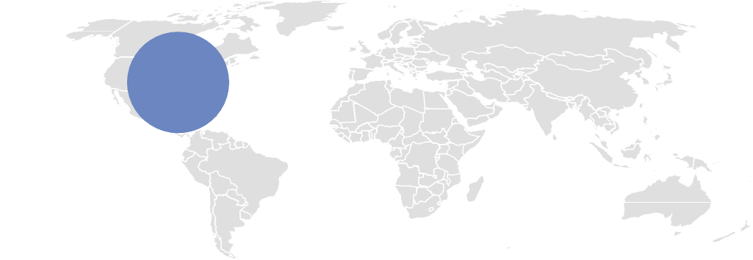









IBM General Overview
IBM predominantly provides software, infrastructure, and consulting solutions to large enterprises worldwide
A broad portfolio of customized solutions…
…saw steady growth, with Software as the largest segment…
Financing
Supporting clients with the acquisition of IBMs’ information technology systems, Software and Services
Software
Revenue of IBM in $ m 2019 - 2023
Open-source hybrid Cloud platforms through Red-Hat as well as data and AI automation and security solutions
CAGR 3.9%
57,714
55,180
57,351
60,530
61,900
Software Consulting Infrastructure Financing Other
38.8%
41.5%
42.1%
41.4%
42.5%
Consulting
Guidance for Business Transformation, implementation of new technologies and operationalizing Cloud platforms
Infrastructure
29.3%
29.5%
31.1%
31.6%
32.3%
Innovative infrastructure platform to enable hybrid Multi-Cloud, AI and open- Source solutions to unfold their full capacity
27.3%
2.1%
26.3%
0.9%
24.7%
0.7%
25.3%
0.7%
23.6%
0.3%
2.4%
1.8%
1.3%
1.1%
1.3%
FY 2019
FY 2020
FY 2021
FY 2022
FY 2023
IBM solutions are widely adopted due to various partnerships
…and North America being IBM‘s core market
Revenue of IBM by region in $ m in 2023
Strategic Partnerships
100%
90%
31.666
11.702
Of commercial banks & TMT companies in the FG 500 rely on IBM
Of the world’s top 50 banks are running on IBM zSystems
18.492
Source: (IBM, (2023b,2024a))
Executive |  | Market Analysis |  | Strategic Fit |  | Financial |  | Feasibility |  | Alternative |  | Conclusion
Summary |  |  |  |  |  | Analysis |  |  |  | Solution
17

Slide 18

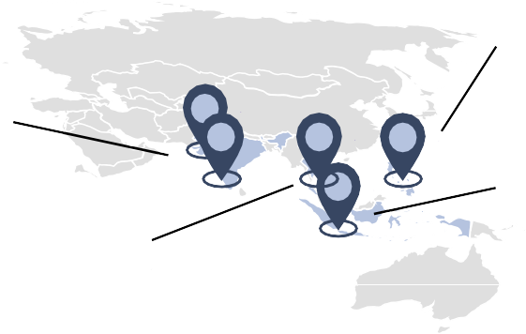
IBM‘s Strategic Direction
In the short term, IBM prioritizes Hybrid Cloud and AI initiatives while pursuing opportunities in emerging markets
Prioritizing Hybrid Cloud and AI with an eye on future opportunities
Recent moves shaping IBM’s strategic direction
In 2021, IBM spun off Kyndryl, its former managed infrastructure services business, to focus on its Hybrid Cloud and AI business
IBM predicts a future with strong demand for Hybrid Cloud and AI solutions
The company is investing in large language models to co-create AI applications
Additionally, IBM leverages its expertise to consult clients on the implementation
and rollout of these AI applications
Despite current limitations in quantum computing, IBM maintains its research
commitment in this field to uphold market leadership and ensure future readiness for sophisticated quantum technologies
Divesting from Kyndryl to focus on hybrid Cloud and AI applications
AI & Hybrid Cloud
Introduction of Watsonx, IBM‘s new AI and data platform
AI
6,775 $ bn investments into R&D in 2023
IBM targets new geographical markets beyond established ones
Newly established presence in the past two years
AI & Hybrid Cloud
IBM Launches $500 Million Enterprise AI
Venture Fund
AI
Expansion of new Innovation Hub in the Philippines, targeting Japanese client services
IBM launched software labs in Gandhinagar and Kochi to foster regional innovation, aligning with its global tech development strategy
Acquisition of Software AG’s iPaas divisions for 2.13 $ bn
Hybrid Cloud
IBM acquires Equine Global, bolstering its Indonesian presence and enhancing hybrid Cloud and AI services
Krungthai Bank and IBM launch IBMDT joint venture to boost the bank's tech workforce and infrastructure
Source: (Thompson, 2015), (IBM Newsroom, (2021, 2023a, 2023b, 2023c, 2023d, 2023e)), (Hindustan Times, 2023), (Consultancy.asia, 2023)
Executive |  | Market Analysis |  | Strategic Fit |  | Financial |  | Feasibility |  | Alternative |  | Conclusion
Summary |  |  |  |  |  | Analysis |  |  |  | Solution
18

Slide 19

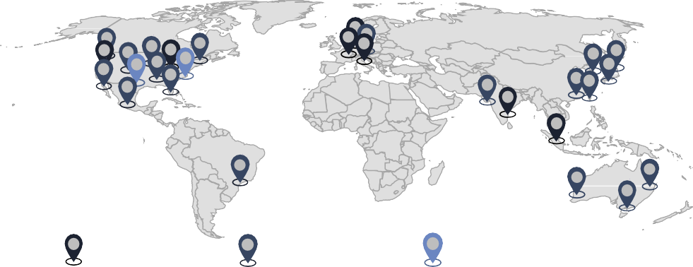
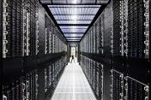

IBM’s Infrastructure Segment
IBM lags behind competitors in the Cloud market by number of data centers
IBM's infrastructure offering is built on three main pillars…
…while key markets include the US, Europe and APAC
Worldwide locations of IBM data centers and network PoPs
Computing
Computing, highlighted by IBM Cloud Virtual Servers and Bare Metal Servers, caters to varied computing needs, from scalable virtual instances for dynamic applications to dedicated physical servers for intensive workloads.
Networking
Central to IBM's Networking offerings is the IBM Virtual Private Cloud, designed to deliver secure and isolated network environments and to facilitate enhanced connectivity and protection for Cloud resources.
Container
Management
This section highlights IBM's Kubernetes Service, which provides managed environments for deploying and scaling applications in containers. It's designed to facilitate Cloud- native development with tools for better resource management and application scaling.
Data Center Network PoP Federal Data Center
...evident in falling revenues from infrastructure solutions
IBM operates only 46 data centers, underperforming its competitors…
Worldwide market share of Cloud infrastructure providers in Q4 2023
Infrastructure segment revenue overview ($ m) and gross margin (%)
46
20.000
CAGR -2,2%
AWS
Azure Google Cloud Alibaba Cloud Salesforce IBM Cloud
Oracle Tencent Cloud
31%
24%
15.775
14.533
14.188
15.288
14.592
13.969
11%
15.000
4%
10.000
55.6%
57.5%
55.3%
52.8%
56.0%
56.1%
3%
IBM operates 46 data centers and Network PoPs worldwide, fewer than its competitors
2%
5.000
2%
41.8%
42.1%
42.4%
38.2%
36.8%
37.2%
2%
0
2019
2020
Gross margin
2021
Revenue
2022 2023
Infrastructure support
2024E
Source: (Krewell, K., 2022), (SES, 2018), (IBM, (2017))
Executive |  | Market Analysis |  | Strategic Fit |  | Financial |  | Feasibility |  | Alternative |  | Conclusion
Summary |  |  |  |  |  | Analysis |  |  |  | Solution
19

Slide 20



IBM’s Software Segment
IBM leads the self-contained software unit market but underperforms in the AI market and is middle-of-the-pack for Cloud software applications
IBM delivers 451 specialized software solutions across ten distinct fields
IBM’s Red Hat leads in self-contained software units
Analytics
Application Development
Cloud
Blockchain
Consulting Service
Market Leaders in Technology Infrastructure Management
Challengers SUSE Tencent _{Cloud} Huawei | Leaders Amazon Web Services _{Google} Microsoft Red Hat VMware Alibaba Cloud
Canonical Oracle Mirantis Serie 2 Niche Players | Visionaries
Business Operations
Data Storage
Cybersecurity
IT Infrastructure
Cat.topic
IBM’s competition includes:
A stable growing Segment
Enterprise software market share by
Company
Software segment revenue ($ m) and gross margin
CAGR 5.0%
Ability to execute
AWS 9%
Oracle 7%
30,000
26,308
27,713
25,000
22,408
22,927
23,426
25,037
Other 58%
20,000
79.8%
80.1%
80.3%
Completeness of Vision
Microsoft 5%
IBM Salesforce
4% ^{4%}
15,000
78.0%
78.3%
79.6%
10,000
Red Hat's leadership status strengthens IBM’s software and Cloud application capabilities
Cisco
4%
_{SAP} Google Adobe
5,000
4%
2% 2%
Accolades for Red Hat OpenShift in container and DevOps management underscore the effectiveness of IBM's integrated development solutions
Vmw are
0
2019
2020
2021
2022
2023
2024E
Source: (IBM, 2020), (Red Hat, 2023), (Garnter 2023) (Statista, 2022)
Executive |  | Market Analysis |  | Strategic Fit |  | Financial |  | Feasibility |  | Alternative |  | Conclusion
Summary |  |  |  |  |  | Analysis |  |  |  | Solution
20

Slide 21







IBM’s Cybersecurity Solutions
IBM is a global leader in the cybersecurity solutions space but lags behind in data center security
IBM offers a wide array of customizable cybersecurity solution
Thanks to high R&D investments…
...IBM reaps cybersecurity patents...
Fraud Protection
Detection and Response
QRadar® SIEM
QRadar® SOAR
QRadar® NDR
…
Annual R&D spending (USDm)
Cybersecurity Patents Holders (2002 -
2022)
Trusteer ® Pinpoint Detect
Trusteer ® Pinpoint Assure
Trusteer ® Mobile
Trusteer Rapport ®
+3,5%
6.775
7.043
31,001 | 30,877
 |  | 25,026
 |  |  | 19,430 | 18,407
IBM | Microsoft | Huawei | Samsung | Intel
5.936
6.262
6.488
6.567
Identity and Access
Management
Mainframe Security
Verify Identity
Verify Governance
Verify Privilege
Manager
…
Attack Surface Management
Randori Recon
zSecure Admin
zSecure Alert
zSecure Audit
…
Data Security
Guardium® Insights
Guardium® Data Protection
Guardium® Data Encryption
…
Mobile Security
MaaS360®
2019
2020 2021 2022 2023 2024E
Further opportunities for IBM’s cybersecurity portfolio
...and offers world-class solutions
…making it the industry leader
IBM’s industry leading cybersecurity solutions have empowered MLSE to achieve significant reductions of:
>80% >90%
Market share cybersecurity solutions
Trellix ^{VMware}
Network Firewall Solutions
While IBM offers a solid suite of network security solutions in QRadar ®, IBM lags behind other providers (e.g. Fortinet, Palo Alto) when it comes to Intrusion Prevention Systems (IPS), Firewalls and network analytics.⁴
Cloud and Data center Security
IBM has a vast array of Cloud Security features but falls behind when it comes to tailored solutions for data centers & cloud providers compared to competitors.
Turnkey Solutions for SMEs
IBM’s product portfolio is oriented towards Large-to- Medium Enterprises, often requiring extensive setup and management resources. IBM could capture a share of the growing SME market by offering more turnkey and automated solutions.
2.0%
Palo Alto Networks
Accenture
Broadcom
2.0%
4.0%
5.0%
_{5.0% 5,0%} Cisco
Other 50,0%
11,0%
IBM
in time spent investigating security threats due to enhanced first-level triage
in overall security events generated, thanks to IBM’s customized playbooks
16,0%
Microsoft
Source: (Cybersecurity Insiders, 2023), (IBM, (2024b), (GlobalData Plc, 2022), (Gartner, 2022)
Executive |  | Market Analysis |  | Strategic Fit |  | Financial |  | Feasibility |  | Alternative |  | Conclusion
Summary |  |  |  |  |  | Analysis |  |  |  | Solution
21

Slide 22
STRATEGIC FIT
Equinix
The Brain
The Fuel
The Machine

Slide 23
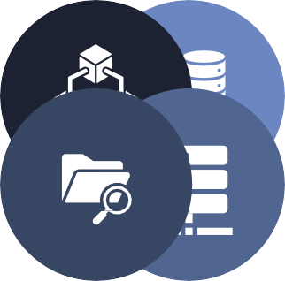

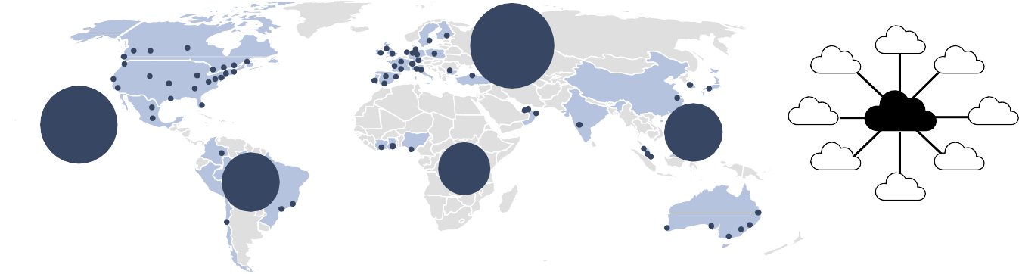
Equinix General Overview
Equinix owns and operates Cloud computing infrastructure, providing compute and storage to some of the largest Cloud players
Equinix is characterized by a unique company structure operating four segments
The company saw a steady growth in revenues…
Data Centers
Provides fully equipped data center rentals with direct connectivity in Equinix’s global network. Billed based on customer usage, generating monthly monthly recurring revenue (MRR)
Digital
Provide Networking-as-a- Service to avoid the costs of buying and maintaining infrastructure. Fees depend on usage and capacity, ensuring steady MRR
…with colocation as the biggest driver
Interconnection
Equinix revenues in $ m
Connects businesses directly within and between Equinix’s data centers across the globe. Billed based on use from a customer and generates MRR
REIT Structure
Equinix is organized as a Real Estate Investment Trust, which subjects it to a favorable 13.8% corporate tax rate.
However, Equinix must distribute at least 90% of its taxable income in the form of dividends to its shareholders
+10.2%
8,188
6,636
7,263
5,562
5,999
Colocation
Professional service bundle for shared IT infrastructure support, eliminating the need for clients to invest in personal infrastructure
2019
Through 70+ data center locations worldwide, Equinix…
2020 2021 2022
…serves an elite customer base
2023
Monthly recurring revenue by segment
Worldwide locations of Equinix data centers
Customer Network
6.0%
2.0%
Equinix's customer base includes top-tier digital solution providers like Microsoft Azure, Amazon Web Services, SAP and many more all utilizing Equinix's robust data centers for their operations
18.0%
#27
#24
#16
Equinix
74.0%
#3
#4
Collocation
Interconnections
Managed Infrastructure
Other
Source: 10-K (Equinix Inc, 2023))
Executive |  | Market Analysis |  | Strategic Fit |  | Financial |  | Feasibility |  | Alternative |  | Conclusion
Summary |  |  |  |  |  | Analysis |  |  |  | Solution
23

Slide 24




Strategic direction
Equinix is aiming to retain its leading position in colocation & data centers, whilst expanding capacity in face of future demand
Countering full utilization Equinix invests in new data centers
Equinix is slowly reaching maximum utilization of its capacities…
78% 81% 80%
Equinix aims to maintain its leadership and global presence
while delivering superior quality
This requires sustaining strength in current markets, penetrating new ones, and constantly enhancing quality
Currently Equinix maintains the fastest server upload speeds,
showcasing its commitment to quality and global reach
However, Equinix is approaching full server capacity, with
demand anticipated to increase
To address this, Equinix is significantly investing in new data
centers worldwide
of Equinix's data center capacity in the Americas is currently utilized
of Equinix's data center capacity in EMEA is currently utilized
of Equinix's data center capacity in APAC is currently utilized
Equinix stands out with superior global presence and quality
…prompting significant global investment in new facilities
Data center investments in: Total Capex Sellable Cabinets
Global Reach
Upload Speed
Americas | $ 1,435m | 13,025m
EMEA | $ 805m | 11,175m
APAC | $ 541m | 10,550m
Equinix, with 70+ locations worldwide, excels in supporting leading Cloud and software companies. Their robust infrastructure, complemented by planned expansions, reinforces their substantial global presence
Equinix distinguishes itself by leveraging the unique capabilities of Equinix Fabric and Fast Connect, offering data uploads up to 14 times faster than conventional internet, with minimal latency of just 75 ms, setting a new standard in the industry
Source: (Panchal, 2022), (Equinix, 2024)
Executive |  | Market Analysis |  | Strategic Fit |  | Financial |  | Feasibility |  | Alternative |  | Conclusion
Summary |  |  |  |  |  | Analysis |  |  |  | Solution
24

Slide 25





Equinix in the Cloud / colocation market
Equinix’s leading market position is solidified through high quality-of-service and a ‘walled-garden’ approach to customer retention
Equinix leads the colocation market with a 13% share
Operational performance stems from strong pricing power
18.0% 9.5%
Colocation market share by company
>>
Low Churn rate
Equinix boasts an exceptionally low quarterly churn rate of only 2.2%, underscoring its remarkable ability to retain customers.
Equinix 13%
Equinix has maintained its position as the market leader in the data center industry since at least 2014
Chinese Operators 13%
Equinix boasts an operating margin of 18.0%, significantly surpassing competitors such as Digital Realty Trust, which has a 9.5% margin.
Others
50%
Digital Realty 11%
NTT 6%
Bargaining power
Equinix, leveraging its significant bargaining power, has the ability to increase contractual prices annually by 2- 5%.
DB
_{CO} 2%
3% KDDI
2%
>>
Three main drivers enable Equinix’s superior position
Equinix, with its superior quality, manages 96% of internet traffic
Recurring Revenue
With over 90% of total revenues predicted to be recurring, the company demonstrates resilience in revenue generation, ensuring stable cash flows
#1
96%
Of all internet traffic flows through Equinix’s data centers
Switching Costs
The recurring revenue model is supported by the stickiness of interconnection
leases, due to the global reach of the business, contributing to high-margins
Average global uptime for data transmission, positions Equinix ahead of its competition
Colocation provider in the industry according to Gartner
Scaling
Equinix allows businesses to scale flexibly and globally, due to the unique global
reach and scale of servers allowing multinational companies to operate world-wide.
99.9%
Source: (Stratton, 2022); (Synergy Research Group, 2022); 10-K (Equinix Inc, 2023))
Executive |  | Market Analysis |  | Strategic Fit |  | Financial |  | Feasibility |  | Alternative |  | Conclusion
Summary |  |  |  |  |  | Analysis |  |  |  | Solution
25

Slide 26

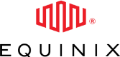
Equinix Key Challenges
Equinix faces challenges in its high SG&A expense, reduced REIT flexibility, and high reinvestments needs
Equinix's SG&A expenses represent 65% of its operating costs
Equinix faces full utilization and needs to invest in new facilities
80%
Equinix must invest in additional data center locations to maintain its market position
Equinix’s SG&A expenses stand at
$1,6B
Which stands for
65% of All
Operating Expenses
Small Data Center (1-3 MW capacity): Costs can range from $10 million to $25 million.
Medium Data Center (5-10 MW capacity): Costs can escalate to between $25 million and $200 million.
25% of it being stock based
compensations
Leaving the company with a 18% operating margin (2023)
of Equinix's available Cloud capacity is already utilized, approaching maximum utilization in the foreseeable future
Large Data Center (10+ MW capacity): For very large or hyperscale data centers, the initial investment can exceed $1 billion.
Equinix REIT structure limits its power to act
In 2020, Equinix encountered a significant data breach
Tax Treatment. REITS are required to distribute 90% of their taxable income to shareholders as dividends, which are double-taxed
2020 Ransomware attack
Tax Inefficiency for Shareholders. The double taxation of profits and dividends can be higher than capital gains tax rates.
4.5m
was the ransom amount specified by a hacker group in their 2020 cyberattack against Equinix
In September 2020, Equinix experienced a ransomware attack that was contained to its internal systems, without impacting its data center operations or customer data. The company responded promptly, involving law enforcement and implementing containment and mitigation measures. Equinix did not disclose if the ransom was paid but enhanced its cybersecurity post- attack to prevent future incidents.
Shareholders
90%
Taxable profits
Limited Re-Investment. Due to a small share of profits ending up as retained earnings, reinvestments are severely curtailed.
Operations
Lack of Control. REIT investors have little control over investment decisions or the properties in the REIT’S portfolio
10%
Taxable
profits
$20b
Cyber insurance market by 2025. Up
from $3.5b in 2018
Source: (10-K (Equinix Inc, 2023))
Executive |  | Market Analysis |  | Strategic Fit |  | Financial |  | Feasibility |  | Alternative |  | Conclusion
Summary |  |  |  |  |  | Analysis |  |  |  | Solution
26

Slide 27
STRATEGIC FIT
STRATEGIC FIT
The Brain
The Fuel
The Machine

Slide 28




Potential Synergies
The potential for cross-selling, up-selling, market power capture, and end-to-end capability synergies exist between IBM and Equinix
Post-acquisition of Equinix, IBM enhances its cross-selling capabilities,
directly targeting Equinix’s and IBM’s customer base. Further it boosts Cloud
infrastructure, facilitating superior service delivery alongside its established software offerings. This strategic integration allows IBM to offer comprehensive Cloud solutions to a wider audience, enriching customer experiences and driving business growth.
Cross-Selling
After acquiring Equinix, IBM enhances its upselling potential by tailoring both its software to Equinix's cloud solutions and Equinix's cloud infrastructure to IBM's software, ensuring optimal performance and enabling the sale of enhanced products at higher prices. Further it enables IBM to larger comprehensive packages to current clients. These upscale enhancements affirm IBM's commitment to delivering next-level technological advancements and support.
Up-Selling
IBM is able to solidify its presence in established markets like the US, Europe, and East Asia, while utilizing Equinix's footprint to enter new territories in South America, the Middle East, and Africa. This strategic move enhances IBM's global reach and market influence. The enhanced brand presence from the merger increases IBM's bargaining power, reinforcing its global dominance.
Market Power
End-to-End Capabilities
Further IBM transforms into a one-stop shop, offering extensive end-to-end capabilities across the entire value chain. Previously, IBM's infrastructure division was smaller and diminishing; now, with Equinix's resources, IBM can offer comprehensive Cloud services complementary to all clients. This strategic enhancement positions IBM as a complete solution provider, catering to diverse client needs.
Strategic Fit
No Strategic Fit
Source: (Lindner, 2020), (Little, 2019), (Nelson, 2021), (Macquarie, 2021)
Executive |  | Market Analysis |  | Strategic Fit |  | Financial |  | Feasibility |  | Alternative |  | Conclusion
Summary |  |  |  |  |  | Analysis |  |  |  | Solution
28

Slide 29


Cross and Up-selling Opportunities
Up-selling a wider product range and Cross-sell comprehensive and improved solutions is a key benefit of vertical integration
Cross-selling to existing customers holds strong potential
Up-selling enhanced products presents considerable potential
Following the merger, IBM can adapt its software solutions to run optimally on Equinix's cloud infrastructure, presenting an opportunity to enhance offerings and upsell improved solutions to clients
IBM Software Solutions
Existing IBM
Customers
Existing Equinix
Customers
Post-merger, Equinix has the potential to optimize its cloud infrastructure for IBM software, thereby improving solution performance and enabling the upselling of superior services to clients
The Partnership allows IBM to offer existing customers enhanced services by cross- selling Equinix Cloud solutions alongside their current software
IBM has the capability to cross-sell its software solutions to existing Equinix customers, providing them with advanced, integrated technology offerings.
<<
Equinix Cloud Solutions
Vertical integration enables up-selling of new solutions
IBM can now offer existing customers preferential access to Equinix Cloud solutions, akin to Equinix's Azure model, with their current software applications
Existing Equinix customers now have access to IBM's consulting expertise, enhancing their strategic and technological capabilities.
Leveraging Equinix's network, IBM now upsells comprehensive packages, combining software and Cloud services, replacing smaller standalone software offers at a higher price point.
Applications
>>
Platforms
Additional Cloud provided by Equinix
Infrastructure
Source: 10-K (Equinix Inc, 2023))
Executive |  | Market Analysis |  | Strategic Fit |  | Financial |  | Feasibility |  | Alternative |  | Conclusion
Summary |  |  |  |  |  | Analysis |  |  |  | Solution
29

Slide 30


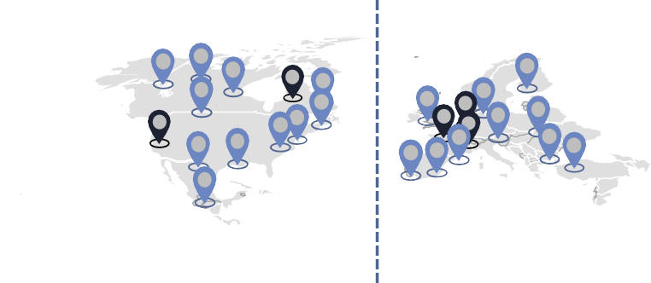
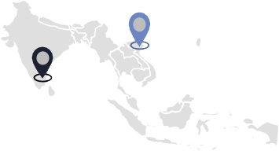
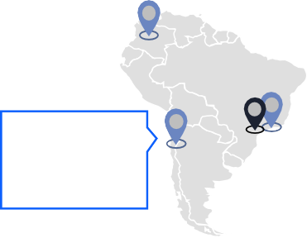
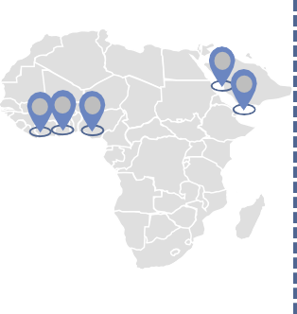


Geographic Expansion and Value Chain Integration
A merger would consolidate core markets, allow IBM Cloud to expand internationally and cover all layers of the Cloud-computing value chain
The merger will increase concentration in IBM’s key market…
IBM expands its cloud offerings, becoming a true one-stop…
Combined data center locations of IBM after the merger with Equinix
Combined offerings of IBM and Equinix
Applications
IBM
One-Stop-Shop
Expand infrastructure and hardware offerings to be fully vertically integrated
Platforms
Infrastructure
Equinix
& IBM
IBM Data Center
Equinix Data Center
Hardware
…while also expanding into new markets
… and now fully servers all layers in the value chain
Additional data centers IBM gains from the merger with Equinix
Cloud-computing value chain
Hardware and Software Providers
Data Center Operators
Hosting and Service Companies
Application Platform Developers
Application
Developers
New locations in South America IBM gains with the merger
Software-as-a-Service (SaaS)
New locations in Africa IBM gains with the
New locations in Australia IBM gains with the merger
BM, with expanded capabilities, now offers sufficient cloud services to all clients
Platform-as-a-Service (PaaS)
merger
Infrastructure-as-a-Service (IaaS)
Expansion in emerging markets for IBM
Source: 10-K (Equinix Inc, 2023)
Executive |  | Market Analysis |  | Strategic Fit |  | Financial |  | Feasibility |  | Alternative |  | Conclusion
Summary |  |  |  |  |  | Analysis |  |  |  | Solution
30

Slide 31
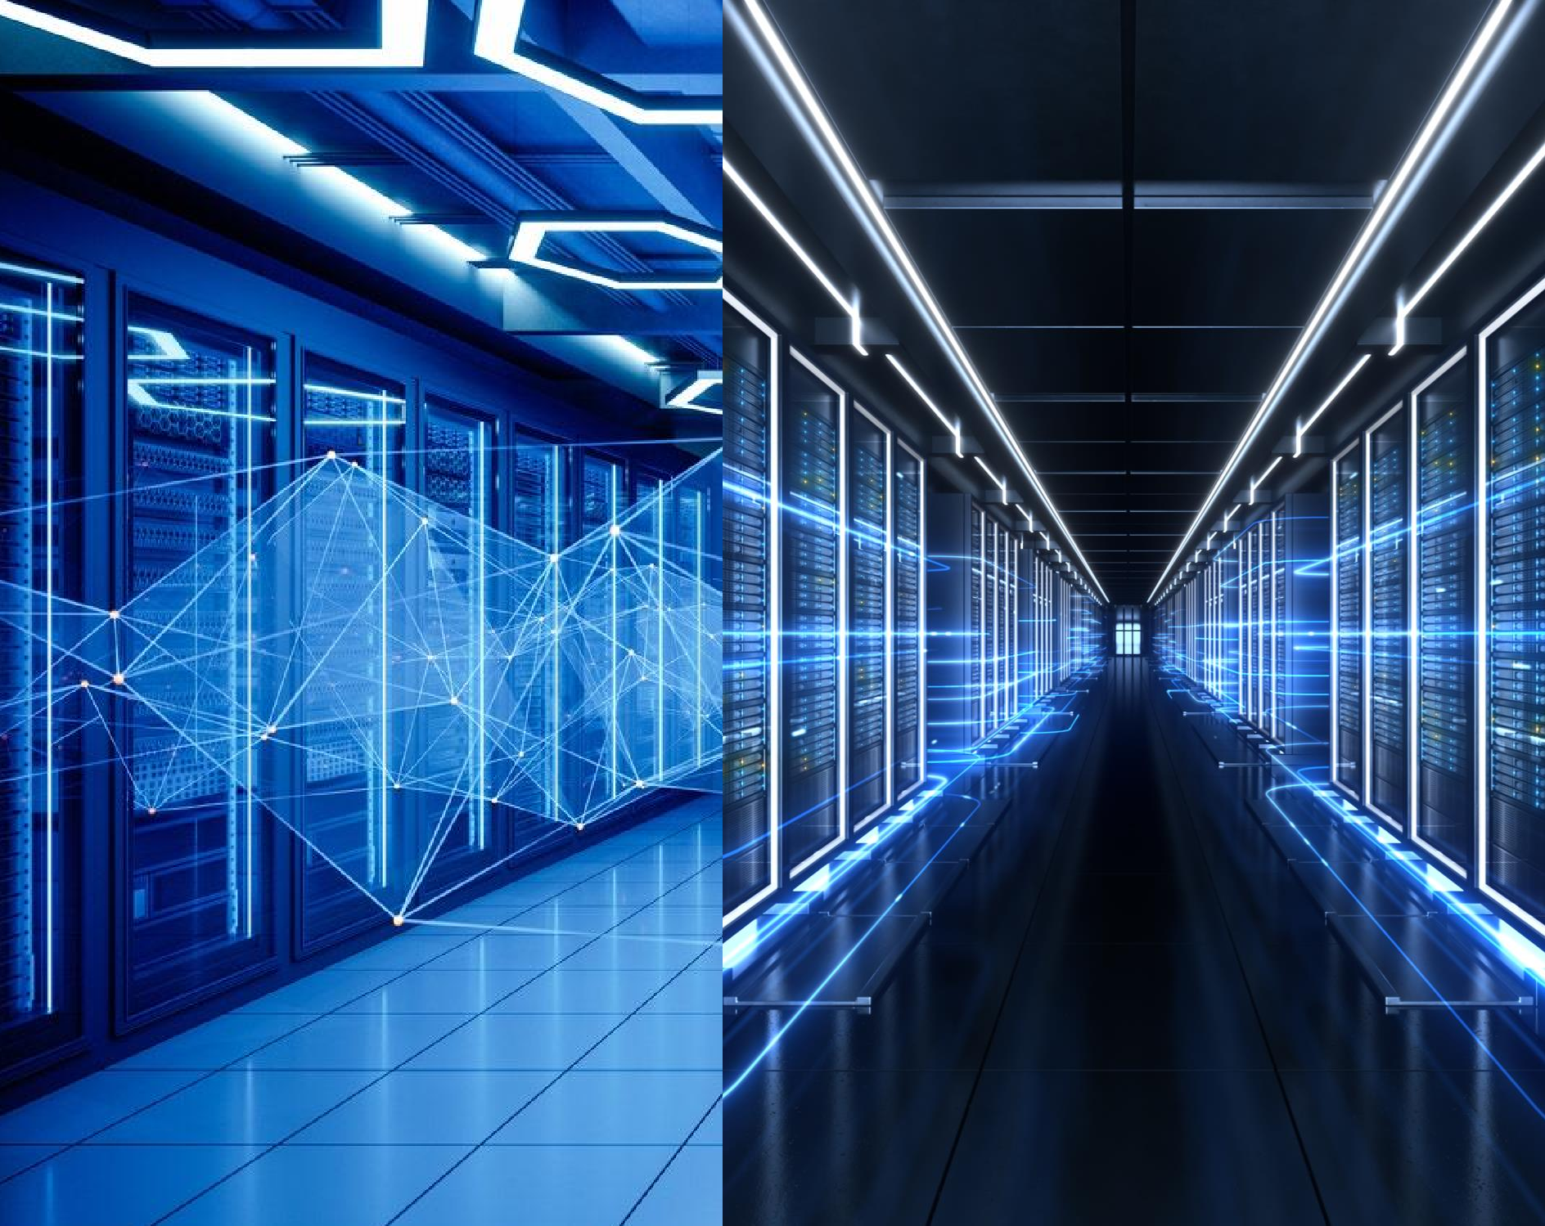
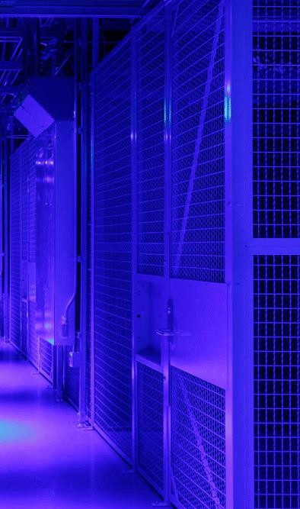
FINANCIAL ANALYSIS
COMPARABLES
DISCOUNTED
CASH FLOW
SYNERGIES
The Outside
The Inside
01 + 01 = 03

Slide 32



FINANCIAL ANALYSIS
COMPARABLES
The Outside
The Inside
01 + 01 = 03

Slide 33
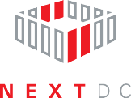














Potential Peer Group
Data center operators, digital infrastructure providers, and Cloud service providers are potential peer groups for Equinix
1.
Data Centers
Similar business model and corporate structure as REIT. Own and operate data centers and provide colocation services.
2.
3.
Digital Infrastructure
Cloud Providers
Support connectivity and communication.
Often also own and operate data centers.
Also facilitate connectivity and often own data centers themselves. Customers of Equinix for xScale data centers.
Source: 10-K (Equinix Inc, 2023)),
Executive |  | Market Analysis |  | Strategic Fit |  | Financial |  | Feasibility |  | Alternative |  | Conclusion
Summary |  |  |  |  |  | Analysis |  |  |  | Solution
33

Slide 34

Comparable Company Selection
Cloud providers were eliminated because they don't share the same revenue and cost drivers as Equinix
Market size
Market CAGR
Brand relevance
Revenue drivers
Cost drivers
Retained
 | - | 8.33% (‘24-’28) | - | Interconnections & physical locations Churn rate Customer base Geographic diversification | Energy efficiency & utility cost Utilization Repairs & maintenance Rental payments | -
Data Centers | $329.3bn (‘23) | 6.56% (‘24-’28) |  | Interconnections & physical locations Churn rate Customer base Geographic diversification | Energy efficiency & utility cost Utilization Repairs & maintenance Rental payments
Digital Infrastructure | $233.7bn (‘23e) | 23.60% (‘23-’32) |  | Interconnections & physical locations Churn rate Customer base Geographic diversification | Energy efficiency & utility cost Utilization Repairs & maintenance Rental payments
Cloud | $595.4bn | 11.37% |  | x Interconnections & physical locations Churn rate Customer base x Geographic diversification | Energy efficiency & utility cost Utilization x Repairs & maintenance x Rental payments
Providers | (‘23) | (‘24-’28)
The dependency on physical facilities and property management distinguishes data centers
and digital infrastructure from Cloud providers
Data centers is the most comparable
segment
Source: (Statista, (2023f, 2023e)), (Yahoo Finance, 2023a)
Executive |  | Market Analysis |  | Strategic Fit |  | Financial |  | Feasibility |  | Alternative |  | Conclusion
Summary |  |  |  |  |  | Analysis |  |  |  | Solution
34

Slide 35





Peer Group Analysis
While Equinix is growing faster and is bigger than most of its peers, it is less profitable given disproportionate employee count
Company
overview
Sales FY21-LTM
($ bn)
EBITDA Margin LTM
EBIT Margin
LTM
Organized as a REIT
Leader in global colocation data
7.3
8.2
6.6
+23%
40,2%
centers
Ecosystem larger than next 10 competitors combined
Organized as a REIT
Provides data center, colocation,
and interconnection solutions
+10%
4.4
4.7
5.3
56,8%
24,9%
Over 300 facilities across over 25 countries on six continents
Leading developer and operator of high-performance data centers in China and South East Asia
Offers colocation and managed
Median: 53.4%
Median: 17.6%
+22%
1.2
1.3
43,1%
4,9%
0.9
services
Organized as a REIT
Sponsored by Keppel (asset manager)
First data center REIT listed in Asia
Portfolio of 23 data centers in APAC
+4%
0.20
0.21
0.21
75.6%
75.6%
and Europe
Incorporated in 2010
Network of 12 data centers across major Australian cities
Planned expansion to New Zealand and
+27%
0.18
0.20
0.23
53,4%
15,4%
Malaysia
Equinix has a below-average EBITDA margin due to significantly higher general and
administrative expenses given nearly 2x as high employee count/revenue as peers
Equinix has grown faster than its peers and is the largest provider
Source: (Yahoo Finance, 2024)
Executive |  | Market Analysis |  | Strategic Fit |  | Financial |  | Feasibility |  | Alternative |  | Conclusion
Summary |  |  |  |  |  | Analysis |  |  |  | Solution
35

Slide 36
Peer Group Trading Multiples
Equinix trades at comparable EV/Sales multiples but when incorporating profitability, it trades at a premium to its peers
Enterprise
value ($ m)
EV/Sales
LTM-FY24E
EV/EBITDA LTM-FY24E
P/FFO
LTM
94,869
10,7x
26,2x
37,7x
11,6x
28,8x
10,4x
19,9x
20,1x
61,000
23,0x
11,4x
Median (FY24E): 10.7x
Median (FY24E): 19.9x
Median: 23.0x
4,5x
9,9x
6,960
n.a.
5,3x
12,2x
15,0x
15,4x
19,3x
20,4x
3,219
20,7x
20.2x
42.5x
5,473
n.a.
23.5x
44.0x
FY24E LTM
Equinix trades at higher multiples than its peers, especially regarding its income generating capacity
Source: (Yahoo Finance, 2024)
Executive |  | Market Analysis |  | Strategic Fit |  | Financial |  | Feasibility |  | Alternative |  | Conclusion
Summary |  |  |  |  |  | Analysis |  |  |  | Solution
36

Slide 37

EV/EBITDA vs. EBITDA margins And Equinix Valuation
EBITDA margins explain a part of the variability in multiples. Yet, Equinix proves overvalued compared to its peer group
EV/EBITDA LTM vs. EBITDA Margin LTM
Key Takeaways
EV/EBITDA
Data Center providers trade at higher multiples compared to Digital
Infrastructure
Positive relationship between EBITDA margin and EV/EBITDA for
both peer groups
But EBITDA margins only explain 9.3% of the variability in EV/EBITDA, indicating that other factors like expected growth are also important
Equinix trades at a higher multiple than its EBITDA margin would
suggest
Premium may be due to higher growth or market leadership
45x
NEXTDC Limited
Digital Infrastructure
Data Center
40x
35x
30x
Equinix
25x
American Tower Corp
SBA Communications Corporation
Implied Equinix’s Share Price (Median Peer Group)
20x
Digital Realty Trust Inc.
Keppel DC REIT
Crown Castle
$1,016
$1,033
15x
Data Center only
Iron Mountain Inc
$856
GDS Holdings Limited
$555
$496
$468
10x
Nippon Telegraph and Telephone
5x
DigitalBridge Group
Current
EV/Sales LTM
EV/EBITDA LTM
EV/EBIT LTM
P/FFO Regression LTM
0x
Digital Infrastructure
Equinix is overvalued based on comparable multiples
0% 15%
Source: (Yahoo Finance, 2024)
30%
45%
60%
75%
90%
Executive |  | Market Analysis |  | Strategic Fit |  | Financial |  | Feasibility |  | Alternative |  | Conclusion
Summary |  |  |  |  |  | Analysis |  |  |  | Solution
37

Slide 38

Precedent Transactions
Rising multiples due to high demand from private equity firms and record-breaking deal sizes make an acquisition unattractive
EV/EBITDA multiples for selected precedent transactions
Key takeaways
EV/EBITDA
The market for data center acquisitions is very active, with deal
volume approaching $48bn in 2022 and 187 transactions
Multiples have expanded significantly over time
While strategic buyers dominated previously, private equity firms accounted for 91% of deal volume in 2022, leading to higher demand
Record-breaking deals are happening every year (e.g., CyrusOne in 2023), driven by private equity firms
Median EV/EBITDA is 29.3x, compared to Equinix's current trading
value of 28.8x
But multiples may decline as rising interest rates make
refinancing more expensive for private equity firms
70x
Financial Strategic
Compass Datacenters
x
Brookfield Infrastructure & Ontario Teachers
60x
EV:$2bn
Switch Inc x
Digital Bridge & IFM Investors
50x
InterXion
x
Digital Realty Trust
40x
DuPont Fabros Technology
x
Digital Reality Trust
Offer Premiums (Prior Day Closing Price)
30x
27%
QTS Realty Trust
x
Blackstone
21%
CyrusOne x
KKR & GIP
20%
20x
Ø 15%
15%
15%
Telecity Group x
Equinix
Strong multiple expansion driven by more financial buyers
CoreSite x
American Tower
5%
2%
Telecity Switch CoreSite Group
10x
CyrusOne InterXion
QTS Realty Trust
DuPont Fabros
0x
1/1/15 1/1/16 1/1/17 1/1/18 1/1/19 1/1/20 1/1/21 1/1/22 1/1/23 1/1/24
Precedent transactions indicate a median value for Equinix of
$1,027
Source: (10-K (Switch Inc, 2021)), 10-Q (Switch Inc, 2022)), (Baker and Young, 2015), (Blackstone, 2021), (Data Center Dynamics, 2023), (Gregg, 2023), (Hammond and Tan, 2021), (KKR, 2021), (Mergermarket, 2023),
(Roshan, 2019), (Sen, 2022), (Synergy Research Group, 2023)
Executive |  | Market Analysis |  | Strategic Fit |  | Financial |  | Feasibility |  | Alternative |  | Conclusion
Summary |  |  |  |  |  | Analysis |  |  |  | Solution
38

Slide 39

FINANCIAL ANALYSIS
DISCOUNTED
CASH FLOW
The Outside
The Inside
01 + 01 = 03

Slide 40
Equinix Revenue & Free Cash Flow Projections
Equinix‘s standalone DCF valuation assumptions align with management estimates and project a revenue CAGR of 8.2% (FY24-29)
Cash flow forecast assumptions (base case)
The amount of Equinix data centers is expected to rise
Revenue growth driven by price increases and number of data centers
Estimated FY24 ending cabinet equivalent capacity in line with guidance of
382,000 and reported data centers under construction
FY24-29 revenue CAGR at the lower end of management guidance of 8-10%
given size and lower expected market growth
EMEA grows faster than Americas given higher announced data-center
expansions
Gross margins stabilize and slightly increase given extraordinary margin
depression in EMEA in FY23 due to energy price increases
SG&A expenses decrease as a percentage of revenue due to economies of scale and growth in regions outside the US
Capex during FY24-27 is in line with expectations of $3bn p.a. and decrease as
fewer data centers are built and growth is driven by current facilities
Total number of IBX data centers
+6.7%
236
242
246
250
253
256
258
262
2022 2023 2024E 2025E 2026E 2027E
FCFF is expected to increase by 319 bps by 2029
2028E
2029E
Equinix will increase its revenues in all regions, especially EMEA
Revenue projections by geography ($ bn)
Free Cash Flow forecasts ($ m)
Americas +7.7%
EMEA +10.2%
+8.2%
EBITDA-Margin
+319bps
13.2
1,600
FCFF
43%
11.3
12.3
2.9
1,209
1,236
Asia-Pacific +9.2%
9.7
10.5
2.7
(22%)
1,200
1,075
42%
8.2
8.9
2.1
2.3
2.5
867
7.3
1.7
1.9
4.3
4.6
800
1.6
3.1
3.4
3.7
4.0
(35%)
559
41%
2.3
2.8
400
335
3.9
4.2
4.5
4.9
5.3
5.6
3.3
3.6
(43%)
2022 2023 2024E
Source: (10-K (Equinix Inc, 2023))
2025E
2026E
2027E
2028E
2029E
0
2024E
2025E
2026E
2027E
2028E
2029E
0%
Executive |  | Market Analysis |  | Strategic Fit |  | Financial |  | Feasibility |  | Alternative |  | Conclusion
Summary |  |  |  |  |  | Analysis |  |  |  | Solution
40

Slide 41




Equinix Discounted Cash Flow (Base Case)
Equinix’s free cash flow projections are in line with the observed market trends towards Cloud usage
USDm | 2024E | 2025E | 2026E | 2027E | 2028E | 2029E | 2030E | 2031E | 2032E | 2033E | Terminal
Revenue | 8,898 | 9,669 | 10,476 | 11,346 | 12,254 | 13,195 | 14,021 | 14,700 | 15,203 | 15,507 | 15,818
Growth | 8.7% | 8.7% | 8.3% | 8.3% | 8.0% | 7.7% | 6.3% | 4.8% | 3.4% | 2.0% | 2.0%
EBITDA | 3,621 | 3,935 | 4,316 | 4,697 | 5,110 | 5,542 | 5,942 | 6,284 | 6,556 | 6,746 | 6,881
Margin | 40.7% | 40.7% | 41.2% | 41.4% | 41.7% | 42.0% | 42.4% | 42.8% | 43.1% | 43.5% | 43.5%
D&A | (2,046) | (2,224) | (2,409) | (2,609) | (2,818) | (3,035) | (3,225) | (3,381) | (3,497) | (3,567) | (3,638)
EBIT | 1,575 | 1,711 | 1,907 | 2,088 | 2,291 | 2,507 | 2,717 | 2,903 | 3,060 | 3,179 | 3,243
Tax rate | 13.9% | 13.9% | 14.0% | 14.1% | 14.2% | 14.2% | 14.3% | 14.4% | 14.4% | 14.5% | 14.5%
(-) Taxes | (219) | (239) | (267) | (294) | (324) | (357) | (388) | (417) | (442) | (461) | (470)
(+) NOLs | 219 | 239 | 267 | 294 | 91 | - | - | - | - | - | -
EBIAT | 1,575 | 1,711 | 1,907 | 2,088 | 2,058 | 2,150 | 2,328 | 2,486 | 2,618 | 2,718 | 2,772
(+) D&A | 2,046 | 2,224 | 2,409 | 2,609 | 2,818 | 3,035 | 3,225 | 3,381 | 3,497 | 3,567 | 3,638
(-) Capex | (3,292) | (3,384) | (3,457) | (3,631) | (3,676) | (3,958) | (4,031) | (4,043) | (3,991) | (3,877) | (3,954)
(-) Increase in NWC | 6 | 8 | 8 | 9 | 9 | 9 | (27) | (32) | (35) | (38) | -
Free cash flow to firm | 335 | 559 | 867 | 1,075 | 1,209 | 1,236 | 1,495 | 1,793 | 2,089 | 2,370 | 2,456
Discount factor | 0.952 | 0.898 | 0.848 | 0.801 | 0.756 | 0.714 | 0.674 | 0.637 | 0.601 | 0.568
Present value of FCFF | 319 | 502 | 736 | 861 | 915 | 883 | 1,008 | 1,142 | 1,256 | 1,345
Commentary
Due to economies of scale in headcount general and administrative expenses move closer to that in EMEA & Asia (around 13% vs. 31% in the Americas)
Tax rate below marginal tax rate in US given taxation as REIT
In line with mgmt. target of
~$3bn of capex per year
FY23 – FY27 to expand and
maintain Equinix’s platform
Free cash flow to the firm
was used instead of AFFO
Better reflects high level of capital expenditure to enable growth
Tax rate increases slightly to 14.5% as share of non- taxable operations decreases as a percentage of revenue
Declines as percentage of revenue as more maintenance capex needed and less for expansion
Stock-based compensation not excluded as disproportionately high
Source: 10-K (Equinix Inc, 2023)),
Executive |  | Market Analysis |  | Strategic Fit |  | Financial |  | Feasibility |  | Alternative |  | Conclusion
Summary |  |  |  |  |  | Analysis |  |  |  | Solution
41

Slide 42
Equity Valuation And Sensitivity to Value Drivers
While Equinix appears overvalued under base case assumptions, significant margin improvements could justify its market price
Value per share after -10% / 10% change in value drivers
Base case: $322 Current price: $856
Enterprise value to equity bridge (base case, $ m)
-14,486
44,669
Revenue
growth
$277
$746
(13,061)
+20%
Senior notes
EBITDA
margin
$195
$896
Minority
₉₂₆ interest
Capex
$231
$824
30,183
Leases
(3,723)
(113)
2,156
927
(1)
(671)
Joint
WACC
$251
$836
(17,568)
Cash &
equivalents
Ventures
Fundamental Value Drivers
Base case assumptions result in a 62.4% downside with a fair value of
$322 per share
EBITDA margin has the largest impact on Equinix's value, with a 10% increase in the margin yielding a value of 4.7% above the current share price
WACC also has a large impact on value, but is unlikely to change
assuming equity premiums and interest rates remain stable
A 10% reduction in estimated capital expenditures could bring intrinsic value close to the stock price
Revenue growth has the least impact on value
Overall, increases in cash flow from higher margins through more
efficient overhead and lower capex could increase value materially
Enterprise Debt & Leases
Value
Cash & Associates & NCI
Other assets
Equity
Value
Equinix is overvalued by 62.4% but if it lowers the
disproportionately high SBC, its price could be justified
Source: 10-K (Equinix Inc, 2023)),
Executive |  | Market Analysis |  | Strategic Fit |  | Financial |  | Feasibility |  | Alternative |  | Conclusion
Summary |  |  |  |  |  | Analysis |  |  |  | Solution
42

Slide 43
NAV REIT Valuation
Existing owned data centers have high market value, but disproportionate SG&A expenses significantly reduce firm value
Equinix holds a substantial NOI despite revenue costs
High SG&A and stock based compensation decrease Value
Net Operating Income From Owned Real Estate FY24e ($ m)
5,353
NAV of Equinix Data Centers Adjusted For Overhead ($ bn)
2,757
39,300
4,169
3,901
1,241
268
Income
45,951
High SG&A and stock-based compensation destroy value
332
42,301
Revenue Owned Real Estate
Cost of
Revenue
Leases
Real Estate
Depreciation
NOI Maintanance Adjusted
Capex NOI
62,858
Associates
C
_{ap}3_{e},0_{x}01
56,207
927
Net
NAV Valuation Implications
^{debt} 15,413
41,721
The market value of data centers owned by Equinix is around
$62,858m
Non-recurring revenue were excluded as they are not generated by the real estate itself and were valued separately
Assumed cap rate of around 6.21% given increases in interest rates
But present value of Equinix’s SG&A expenses reduces the value of the firm substantially, confirming that its SG&A expenses are disproportionately high
High expansion capital expenditures depress free cash flow in the DCF but comparatively low maintenance capex (5% of revenue) yields attractive returns from the existing portfolio
-14,486
MV Gross Real Estate
Non-Owned SG&A Real Estate
Enterprise Adjustments Value
Equity Value
Equinix‘s existing data centers have attractive returns but high overhead
and expansion capex reduce firm value
Source: (10-K (Equinix Inc, 2023))
Executive |  | Market Analysis |  | Strategic Fit |  | Financial |  | Feasibility |  | Alternative |  | Conclusion
Summary |  |  |  |  |  | Analysis |  |  |  | Solution
43

Slide 44
Equinix Valuation Summary
Equinix is overvalued according to intrinsic value and trades at an all-time high
Current price:
$856
Comments
Market
Comparables Analysis
Intrinsic Valuation
Precedent Transactions
YTD: 5.9%
1-year: 23.5%
5-year: 97.8%
Trading at an all-time high
52 week range
$662
$892
Low: GDS Holdings Limited
High: NEXTDC Limited
Avg: $1,386
Median: $555
EV/EBITDA LTM
$275
$1,386
-46%
Low: Keppel DC REIT
High: Digital Reality Trust Inc.
Avg: $496
Median: $496
P/FFO LTM
$470
$522
Overpriced by >55%
Low: 1% terminal growth, 6.91% WACC
High: 3% terminal growth, 4.91% WACC
Target EBITDA margin: 43.5%
Revenue growth (FY24-29): 8.2%
DCF
$226
$482
Using the average offer
premium of 15%, the
base-case DCF (NAV) value is 67% (55%) below the offer price of
$984.4
Low: 7.2% cap rate, 6.91% WACC
High: 5.2% cap rate, 4.91% WACC
NOI FY24: $4,169m
Market value real estate: $62,858m
NAV
$337
$583
Low: DuPont Fabros Technology
High: Switch Inc.
Avg: $1,002
Median: $1,021
EV/EBITDA
$553
$1,520
Equinix is overpriced by >55% based on intrinsic valuation and comparables suggest that the
likely acquisition price of $984.4 would destroy substantial value
IBM shouldn‘t buy Equinix
Source: (Yahoo Finance, 2024)
Executive |  | Market Analysis |  | Strategic Fit |  | Financial |  | Feasibility |  | Alternative |  | Conclusion
Summary |  |  |  |  |  | Analysis |  |  |  | Solution
44

Slide 45
FINANCIAL ANALYSIS
SYNERGIES
The Outside
The Inside
01 + 01 = 03

Slide 46
Synergies
Synergies can be generated through offering IBM clients colocation solutions and reducing SG&A expenses
Synergies
Reasoning
Duration
Impact
Revenue Synergies
Offer IBM Cloud Solutions when re-negotiating leases for Equinix customers
Integrate Equinix data centers in consulting offers
Access to larger customer base who already need Cloud solutions
Offer Cloud consulting customers
colocation services
3-5 yrs
SG&A Reduction
Reduce large SBC expenses
Reduce Equinix’s large overhead, which is above that of competitors
Use IBM’s support functions to run Equinix’s facilities
Use IBM sales representatives
to sell data center leases
2-5 yrs
Shared Resources
Combined revenues generated at competitors (e.g. Digital Realty Trust) increase bargaining power
Increase utilization of data centers
Renegotiate more favorable leases
Move IBM connectivity needs to
Equinix, increase utilization & cut spending with competitors
3-5 yrs
Interconnections
Denser network reduces latency
Improved edge computing
capabilities
Combined data centers provide more interconnections and increase flexibility and scalability
Reduce cost per interconnection
1-2 yrs
By combining IBM Cloud and consulting offerings with Equinix‘s colocation facilities, cross-
selling synergies can be generated
Significant potential for cutting cost
Source: 10-K (Equinix Inc, 2023)), (IBM, n.dc.)
Executive |  | Market Analysis |  | Strategic Fit |  | Financial |  | Feasibility |  | Alternative |  | Conclusion
Summary |  |  |  |  |  | Analysis |  |  |  | Solution
46

Slide 47
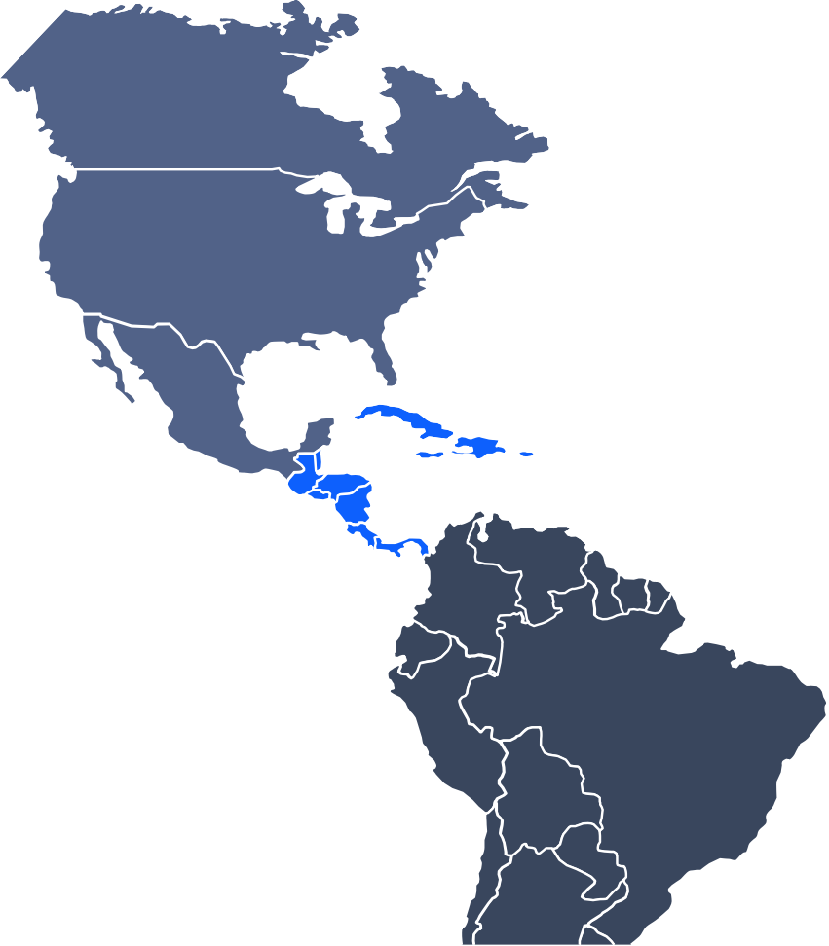

Cross-Selling Synergies
By combining IBM’s offerings with that of Equinix, cross-selling synergies can be generated
IBM And Equinix consolidate the data center market of America
High revenue growth from cross and up-selling synergies
Calgary Vancouver
Seattle
Kamloops
Silicon Valley
Winnipeg
Ottawa
Toronto
Revenue Through Cross-Selling & Up-Selling ($ m)
Montreal
Chicago
Saint John
+12.5%
Cross-Selling & Up-Selling
San Jose
Boston Ashburn
New York Philadelphia
Washington, D.C.
Culpeper, VA
IBM Base Revenue
727
756
786
665
699
Los Angeles
Atlanta
637
Denver
Dallas
Houston
Miami
Mexico City
Bogotá
2024E 2025E 2026E 2027E 2028E 2029E
By offering new and current IBM clients colocation services at
Equinix’s data centers additional revenue can be generated
Denser data center network increases attractivity due to higher computing power and lower latency for clients
Worldwide network improves IBM’s edge computing capabilities, which could make customers choose higher priced offerings
IBM data center
Lima
Equinix data center
Santiago
Rio de Janeiro
São Paulo
Cross-selling & up-selling synergies of $4,253m attainable
Source: (10-K (Equinix Inc, 2023)), (IBM, n.dc.)
Executive Market Analysis Summary
Strategic Fit
Financial Analysis
Feasibility
Alternative Solution
Conclusion
47

Slide 48
Cost Synergies
By reducing Equinix’s number of employees and increasing bargaining power, cost synergies can be generated
Comparison Of EBITDA Per Employee ($)
EBITDA Added Through Headcount Reduction ($ m)
Equinix has a disproportionately large workforce
828k
816k
SG&A Savings
361
385
Severance Payments
321
361
385
459k
212
Ø
250k
260k
125
338
236
71k
GDS Holdings Digital Iron Mountain
Limited Realty Trust
43
147
54
Equinix
American
Tower
NEXTDC
Limited
-11
-22
-24
-17
2024E 2025E 2026E 2027E 2028E
EBITDA Added Through Lease Re-Negotiations ($ m)
2029E
Digital Realty Trust Major Customers FY23
 |  | Tenant | Revenue ($ k ) | % of Revenue | Lease Term in Years
 | 1 | Fortune 50 Software Company | 418,935 | 10.9% | 8.2
 | 2 | Social Content Platform | 212,198 | 5.5% | 4.7
 | 3 | Oracle Corporation | 164,487 | 4.3% | 6.4
 | 3 | Global Cloud Provider | 156,892 | 4.1% | 5.0
 | 4 | IBM | 129,569 | 3.4% | 2.3
 | 5 | Equinix | 93,346 | 2.4% | 5.9
Equinix
27.8
IBM
13,5
13.5
13.7
14.0
No lease expiry
13,5
13,7
14,0
14,3
2024E 2025E 2026E 2027E 2028E 2029E
Synergies of $ 7,933m can be generated through cost-savings
Source: (10-K (Digital Realty Trust Inc, 2023))
Executive Market Analysis Summary
Strategic Fit
Financial Analysis
Feasibility
Alternative Solution
Conclusion
48

Slide 49
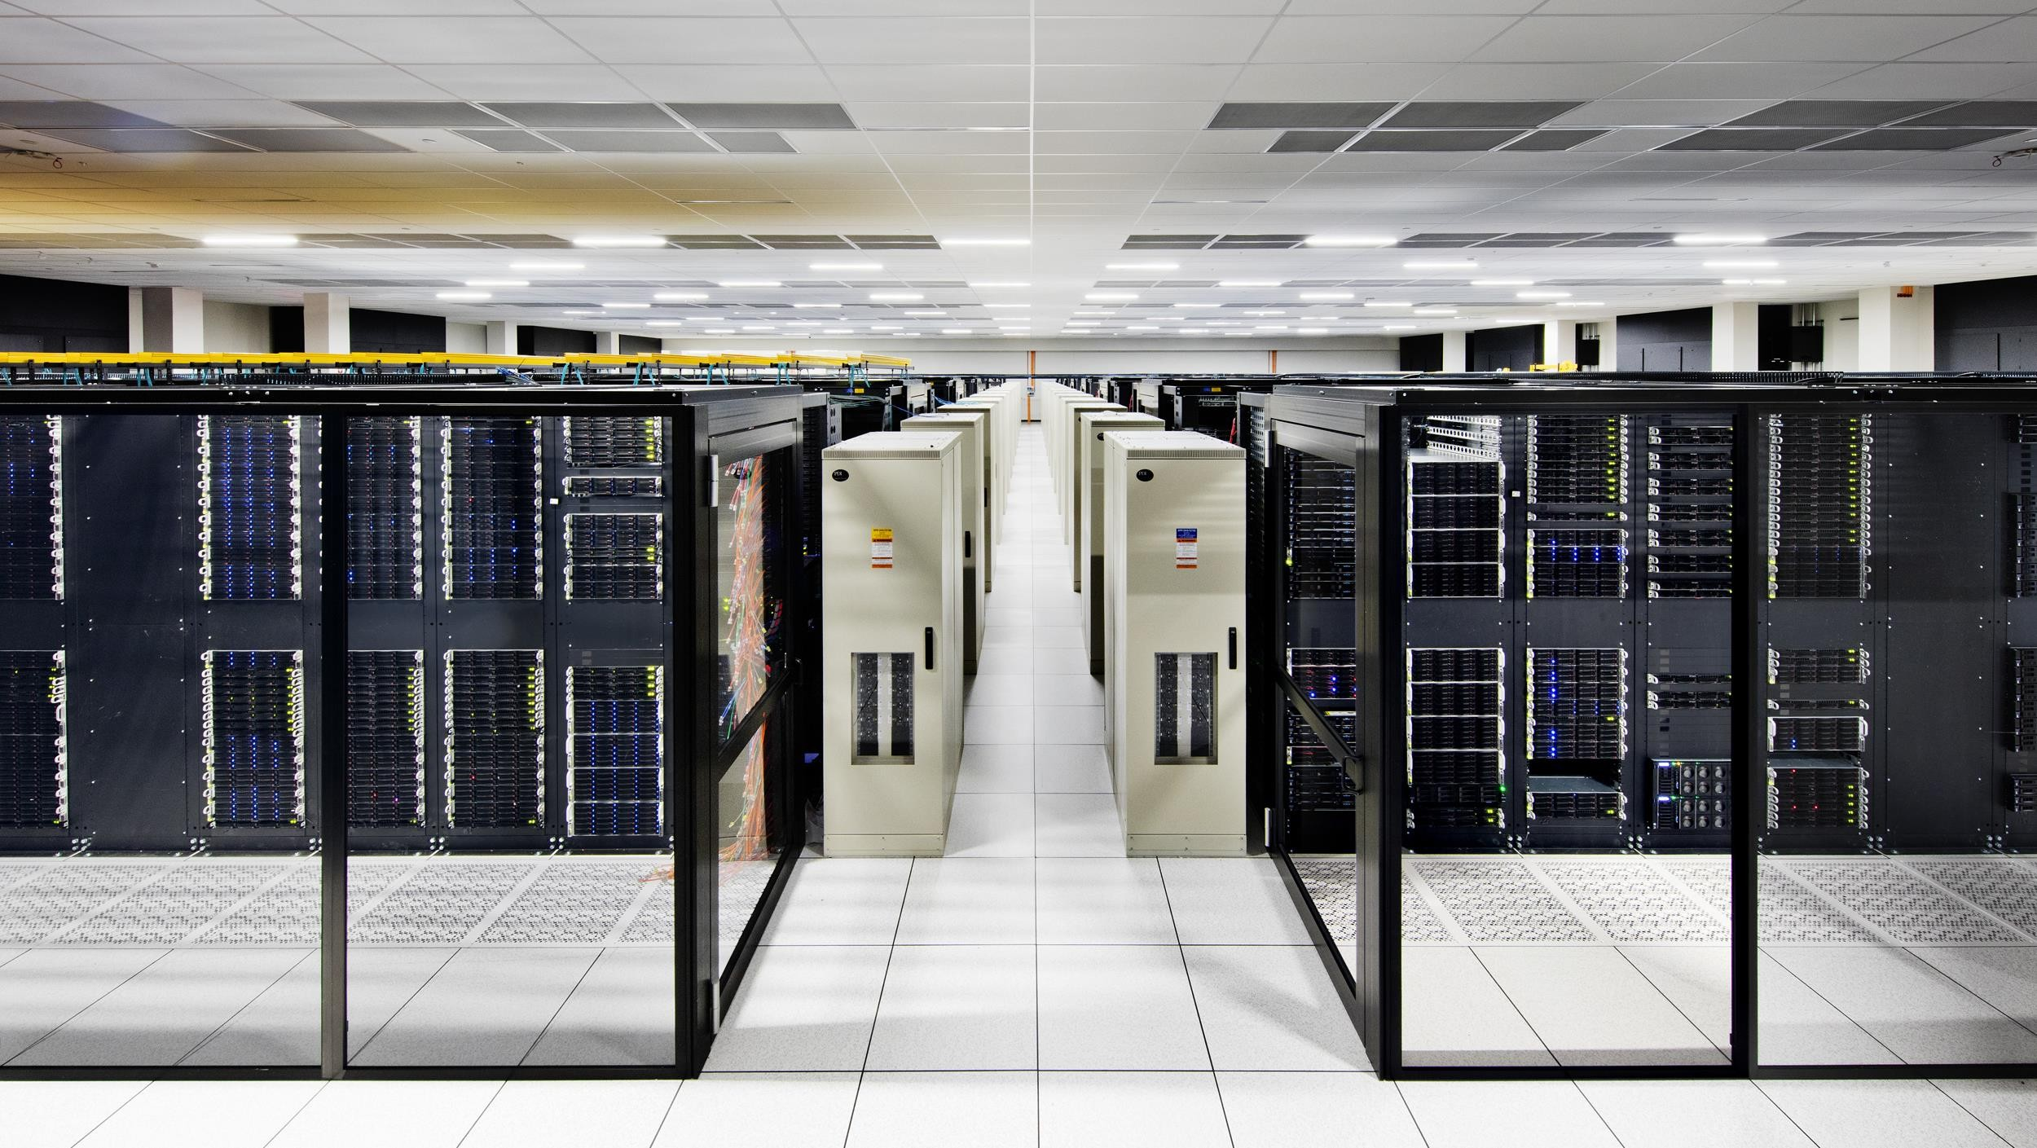
FEASIBILITY
Too Big to Acquire

Slide 50

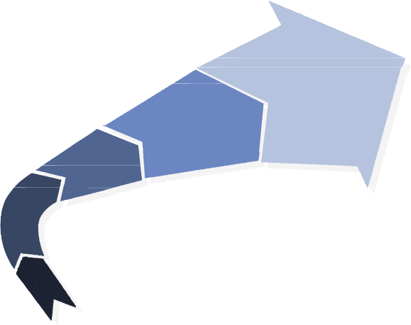










IBM Does Not Acquire Businesses of Equinix’s Size
in the history of IBM, only the Red Hat deal exceeded a $5bn transaction value, implying that Equinix is valued at over 3x IBM’s largest transaction
An acquisition of Equinix would break with IBM’s pattern of smaller acquisitions
Excessive Deal Size
Transaction values of significant IBM acquisitions from 2010-2024 in $ m
IBM’s acquisitions have historically
focused on smaller companies
<$5bn
in transaction value
115,000
110,000
105,000
100,000
95,000
90,000
85,000
80,000
75,000
70,000
65,000
60,000
55,000
50,000
45,000
40,000
35,000
30,000
25,000
20,000
15,000
10,000
5,000
0
Completed
Largest Completed Acquisition Pending
Hypothetical
$94.8.5bn EV
>3x
IBM’s acquisition of Red Hat Inc. for
$31.8bn
in transaction value was the only ever
exception due to exceptional strategic fit
An Equinix acquisition would deviate
even further from IBM’s M&A strategy
Pre-2018 Acquisitions Average deal values pre- 2018 are roughly 5% of Equinix’ enterprise value
Recent Acquisitions Focus on bolstering software offerings and cybersecurity
$31.8bn
Thematic Misfit
IBM’s strategic M&A efforts were focused on bolstering its software offerings and did not include acquiring REITs such as Equinix, resulting in a thematic misfit
Sterling Commerce _{DemandTec}
SoftLayer Technologies
Digital Assets/Weather Channel
Truven Health Analytics
Netezza
Merge Healthcare
Unica Algorithmics Kenexa
^{Advanced Application} Cleversafe Resilient Network Systems
2010 2011 2012 2013 2014 2015 2016 2017 2018
Source: (Bloomberg, 2024), (Refinitiv Eikon, 2024), (IBM Newsroom, 2023a)
2019
2020
2021
2022
2023
2024
2025
2026
2027
2028
Executive |  | Market Analysis |  | Strategic Fit |  | Financial |  | Feasibility |  | Alternative |  | Conclusion
Summary |  |  |  |  |  | Analysis |  |  |  | Solution
50

Slide 51
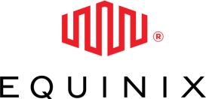

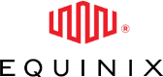
IBM Cannot Merge with Equinix as it is a Real Estate Investment Trust
Equinix is legally classified as a REIT, allowing it to be exempt from federal corporate income tax, an advantage lost through a merger
Equinix is classified as a Real Estate Investment Trust (REIT)
A simple merger does not preserve REIT status
REITs enjoy federal tax benefits if they follow a few key restrictions
Equinix’s favourable taxation would be lost in an IBM merger
Asset and Income Composition
At least 75% of assets must be cash or invested in real estate as well as over 75% of
gross income must stem from real estate
Income Distribution
Mandatory distribution of at least 90% of taxable income to shareholders as dividends.
Structural and Ownership Requirements Must be a qualified entity (corporation, trust, or association) with no more than 50% of shares held by five or fewer individuals.
Tax Status and Compliance
Must elect REIT status and adhere to specific tax filing and operational regulations.
<50%
majority owned
150%
100%
50%
0%
>75%
in RE assets
Payout Ratio
Real Estate of
Gross Income from Ownership of 5
IBM REIT Limit Equinix
Total Assets
Real Estate
Largest
Shareholders
An Umbrella Partnership REIT (UPREIT) preserves REIT status
An UPREIT structure allows IBM to seize control of Equinix indirectly
>75%
in RE gr
income
In an UPREIT transaction, Equinix would contribute its assets to a partnership in exchange for partnership units.
IBM would acquire control of Equinix indirectly
by purchasing these partnership units.
This structure allows the REIT to operate within a larger corporate structure while maintaining its tax-exempt status, as the REIT itself does not directly merge into the acquirer.
Exemption from federal corporate
income tax if classified as a REIT
Umbrella Partnership
PU
> 90%
payout
ratio
Equinix Assets
Following a simple merger, IBM
would not qualify as a REIT!
PU
Source: (IBM Newsroom, 2023c), (IBM, 2024a) (Equinix, 2024)
Executive |  | Market Analysis |  | Strategic Fit |  | Financial |  | Feasibility |  | Alternative |  | Conclusion
Summary |  |  |  |  |  | Analysis |  |  |  | Solution
51

Slide 52

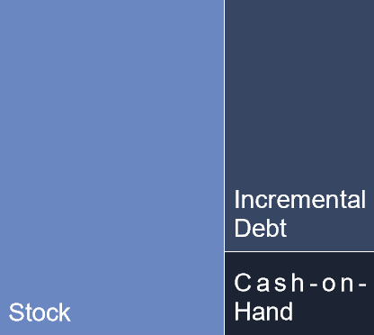


Financing Structure
IBM cannot feasibly finance the transaction value even when using a combination of cash, incremental debt and stock without severe drawbacks
IBM’s largest acquisitions used cash from operations or debt
IBM has insufficient debt capacity to finance the transaction
Historical acquisition financing structures
Analysis of credit rating impact
IBM has historically preferred using cash for acquisitions
For the 2018 acquisition of Red Hat, IBM used cash sourced from operations and issued incremental debt
Debt Is No Solution
IBM would jeopardize their A- credit rating by raising the necessary incremental debt
Debt is an expensive option due to the current elevated interest rates
A-
20Y US Treasury Yields
5,0%
96%
Exclusively Cash Cash & Equity
4,0%
The interest rate environment is not favorable
3,0%
BBB
All of IBM’s recent significant acquisitions used cash-on-hand
2,0%
01.22
04.22
07.22
10.22
01.23
04.23
07.23
10.23
01.24
IBM’s cash covers less than a third of the transaction value
Even combining cash, debt and stock is not enough
Acquisition feasibility using cash-on-hand
Acquisition feasibility and proposed financing structure
94,844
Offer Assumptions USDm
IBM’s EPS
would dilute by
53% from equity considerations!
13,068
Insufficient Cash
IBM does not have sufficient cash-on-hand to buy Equinix
If IBM wants to continue to refrain from using stock, >$41bn of debt would need to be raised
Equinix Net Debt Offer Price Per Share Premium
15'472
985
15%
IBM would need to
raise inordinate
Offer Value
debt, which would
107'912
107,912
Cash Consideration
make Equinix the
Cash Balance
Offer value
Cash from Balance Sheet Incremental Debt
#2 largest LBO in history, rendering the acquisition
107'912
10'791
32'374
Transaction
Value
Cash & Cash
Equivalents
Remainder
Stock Consideration
impossible.
Offer value
Stock Consideration Additional IBM Shares Issued
107'912
64'747
337
Source: (IBM Newsroom, 2023c) (Equinix, 2024), See Appendix for detailed merger model
Executive |  | Market Analysis |  | Strategic Fit |  | Financial |  | Feasibility |  | Alternative |  | Conclusion
Summary |  |  |  |  |  | Analysis |  |  |  | Solution
52

Slide 53
Other Considerations
The acquisition is likely to fail due to difficult post-merger integration in addition to the inordinate transaction size
Low to High Risk | Description of Risk Factor | Evaluation of Severity | Evaluation of Likelihood | Threat Assessment
Antitrust Regulation | Antitrust regulators may intervene if an M&A transaction is believed to lead to the formation of a monopoly The transaction may fail if a deal is believed to reduce competition | Antitrust blockage of the deal has high severity for the acquisition feasibility Regulatory intervention is unlikely unless the HHI exceeds 2’500 or increases by more than 100 | Regulatory intervention is moderately likely HHI Though the data center 432 HHI is well below the _{/10’000} 2’500 threshold at 432
Post-merger integration | Difficulties in consolidating operations, systems, and corporate culture can hinder the integration. Potential disruption of ongoing business and loss of key personnel | IBM and Equinix operate in different businesses and may have conflicting corporate cultures As Equinix is a REIT while IBM is not there might be significant challenges | High, considering the size of both companies as well as the differing nature of their businesses It is likely that post-merger integration will be a lengthy and risky process
Customer Retention | Possibility of customer turnover due to service disruption or changes in service offerings can lessen synergies Dissatisfaction among existing customers may decrease loyalty | Existing customers of Equinix may not intend to adopt IBM offerings Synergies from cross-selling and up- selling may not materialise, and attempts may alienate customers | It is likely that customer retention issues could diminish synergies Some existing customers will not try IBM services, but synergies should materialise at least partially
FX Impact | Foreign exchange rate risk can impact the value of cross-border acquisitions due to uncertain currency translation Costs and benefits may fluctuate based on unpredictable FX rates | Both Equinix and IBM are incorporated in the US, meaning that the acquisition price is not affected by FX risk Equinix’s EU assets’ valuation does depend on foreign exchange risk | The overall likelihood of FX risks to pose a threat to the feasibility of the transaction are low Currency translation effects are unlikely to pose a material risk
Source:
Executive |  | Market Analysis |  | Strategic Fit |  | Financial |  | Feasibility |  | Alternative |  | Conclusion
Summary |  |  |  |  |  | Analysis |  |  |  | Solution
53

Slide 54


Conclusion for Equinix Acquisition Feasibility
IBM should not acquire Equinix as an acquisition would destroy shareholder value and turn out infeasible due to the overvaluation of Equinix
Equinix is overvalued
The acquisition is not feasible
The analysis of Equinix has found that according to Net Asset Value, Equinix is overvalued by about 48.1% and according to the DCF, Equinix is overvalued by 64.2%.
A cash acquisition is not possible. While IBM may issue debt, its credit rating would adjust from A- to BBB as the acquisition requires inordinate levels of debt at high interest rates.
The acquisition of Equinix by IBM would have to include an acquisition premium. This acquisition premium is estimated to be 15% of Equinix’s market capitalization.
Even if IBM were to raise more debt than the second largest LBO in history, it would still need to also issue USD 64.7bn in stock and dilute its earnings per share by 53.8%
After also considering the synergies that could be generated by the combined companies, the purchase price of USD 107.9bn would be too high for synergies of only USD 12.2bn.
As a REIT, Equinix cannot simply merge with IBM as the combined entity would no longer qualify for the privileged taxation of a REIT. This complicates post-merger integration.
IBM should not acquire Equinix
Source:
Executive Summary
Market Analysis
Strategic Fit
Financial Analysis
Feasibility
Alternative Solution
Conclusion
54
54

Slide 55
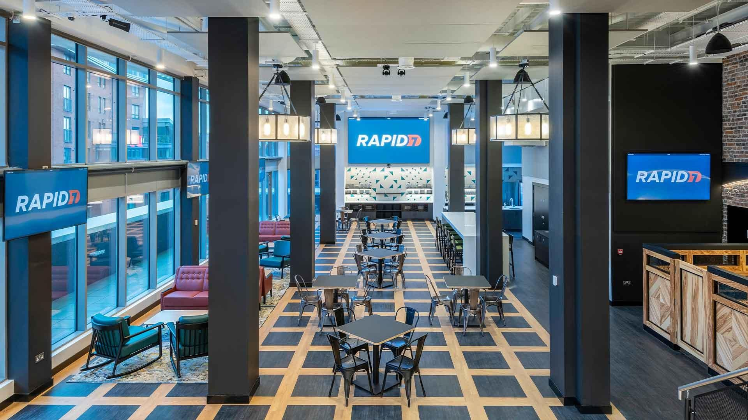
ALTERNATIVE SOLUTION
The Internet of Threats

Slide 56
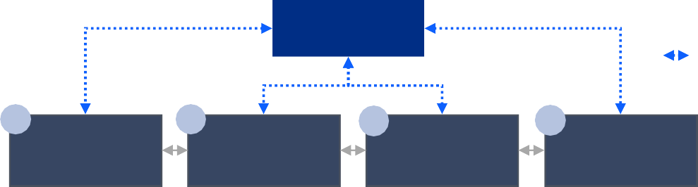
The Future Economy is Digital - and so are its Vulnerabilities
The transformation of the economy means security in the digital world is just as important as in the physical
As digitization continues to transform the economy…
… a few key verticals face hesitancy to deploy innovative, digital technologies out of significant security and safety concerns and high system complexity
Digitization Levels across industries
Operational
Capital
Cloud
Time-to-market, cost or threat management?
Firms face fundamental tensions between business productivity needs and cybersecurity risks.
Currently, only a few industries have fully digitized their operations, their assets, and deployed Cloud technologies to capitalized on the power of data in their business.
As data flows become more significant, this tradeoff becomes more acute.
t
_{Industry Data Sensitivity} Digitization Digitization Deploymen
Media & Telecommunications
Retail & (e-)Commerce
Finance & Insurance
Personal, Local Services
Personal Mobility
Industrial Manufacturing
Shipping and Transportation
Entertainment & Recreation
Government Administration
Military
Healthcare & Hospitals
Every aspect of the ‘digital’ enterprises requires robust cybersecurity models
Digital Leaders
An organization is as vulnerable to cyberthreats as its weakest link: cybersecurity models must be
robust and encompass all nodes in its data network.
Risk Management cultures require company-wide technology deployments.
Digitization Across the Supply Chain: risks & solutions
Advanced Cloud Connectivity
Goods & Services Flows
Data Flows
1
2
Goods / Services Production
3
4
Supply
Employees
Customers
Risks:
Vendor pricing
exposure, material and process leakage, supply interruption
Risks:
Shutdown / disruption,
Trade secret / process leakage, Attacks on production quality
Risks:
Shutdown / Disruption, Process leakage,
Risks:
Client data & security exposure, service disruption
Overall: Cyberthreats have significant monetary, reputational, legal and productive consequences
Digital
Laggards
Necessary Cross-Chain Solutions
Risk & Vulnerability Detection Systems | DevSecOps | IR Planning & Testing
EDR Tools | Managed Service Partners | Risk & Vulnerability Detection Systems
Low
High
Source: (Gartner, 2023), (Statista, n.d.a) (Statista, n.d.b)
Executive |  | Market Analysis |  | Strategic Fit |  | Financial |  | Feasibility |  | Alternative |  | Conclusion
Summary |  |  |  |  |  | Analysis |  |  |  | Solution
56

Slide 57

The Skyrocketing Market Opportunity of Cybersecurity
As the cost of individual and aggregate cybercrime increases, the allocation of investments towards cybersecurity will skyrocket
The cost of cybercrime continues to climb exponentially
With both increases in volume and average costs per data breach, firms are
increasing cybersecurity budgets, generating strong demand in the market.
23.000
The number and severity of cyberattacks is increasing
… and will only continue to do so as both sector-specific and ‘supporting’ technology (Cloud, AI, etc.) trends move more information, goods, services and processes to the digital world.
USD 4.4 The average cost of a (Global, 202 By region | 5M data breach 3) $ m
US | 9.48
Middle East | 8.07
Canada | 5.13
Germany | 4.67
Japan 82% of breaches involve the Private or Hyb | 4.52 Cloud (Public, rid)
Average cost of data breach across industries in 2023, $ m
22.000
Healthcare Finance
21.000
$10,93
20.000
$5,90
19.000
The whole world becomes ‘hackable’
Pharma |  | $4,82
Energy |  | $4,78
Industrials |  | $4,73
Tech |  | $4,66
18.000
Key challenges of cybersecurity at the firm level
& why the trend of exponential cybercrime attacks will continue
17.000
16.000
Low Log Visibility
On average, firms only process and triage 40% of their information logs, and even lower % for SaaS tools used. This is done out of cost saving reasons, but leads to significant gaps in cybersecurity fabrics.
Talent Shortages
Organisations struggle to staff information security professionals as the global shortage of cybersecurity talent grows (est. 770’000
job gap in US
alone)
SMB
Targeting
Increased attacks on smaller firms lacking the critical funding and infrastructure to defend against cyberattacks
Forecast
Prof. Services Transportation Communication
Consumer
$4,47
15.000
Reported
$4,18
14.000
$3,90
13.000
$3,80
12.000
Shifting the paradigm: Firms are recognizing that cybersecurity is more relevant than ever, especially in critical industries, and increasing their budgets correspondingly.
IBM Competitiveness Ranking^{fn}
Low
Medium High
2 Ranking
Related
/ Sub-Solution (Terminology)
11.000
10.000
9.000
Market size & growth estimates, by cybersecurity service, $ bn
8.000
$ bn 1’680-
1’800
₂ Managed Security Services (Outsourcing)
7.000
$ 500
(e.g. IBM MSS)
(aka. MDR)
Blindspot
6.000
(XDR)
N/A
Network & Cloud Workload
Security
5.000
Yearly damages from
cybercrime in the US
$ m
(IBM not directly competing; for IBM
Collab. with Palo Alto
Networks)
₂ Event & Operations Management (SIEM) (e.g. IBM Security Verify, Qradar)
4.000
3.000
TAM
$ billion
₅ Identity & Access Management (e.g. partially IBM IAM; IBM Security Verify)
2.000
₅ Security Consulting
1.000
We Estimate
12x
Growth over next 10 years
(EDR)
(IBM Cyberthreat MS, X-
Force, Threat D&RS)
₅ Compliance & Governance
(e.g. IBM OpenPages)
0
2000 2005 2010
Source: (FBI, 2023), (IBM 2023a), (Gartner, 2023)
$ bn 140-
150
3 IoT Security
(E.g. IBM Watson® IoT
Platform, UEM, QRadar® EDR)
2015
2020
2025
1 (Post-Quantum Cryptography)
Present
TAM
$ 50
5%
Current Penetration
40%
Executive |  | Market Analysis |  | Strategic Fit |  | Financial |  | Feasibility |  | Alternative |  | Conclusion
Summary |  |  |  |  |  | Analysis |  |  |  | Solution
57

Slide 58






Potential Alternative Targets
While IBM could acquire several companies, Rapid7 represents the most promising target
Company
overview
Revenue LTM
(3-year CAGR)
Strategic
fit
Financial
impact
Feasibility
Risks
Incorporated in 2000
Offers endpoint to Cloud data collection and sharing applications
End-to-end threat detection
Cloud risk & compliance solutions
$778m
(23.6%)
Incorporated in 1999
Cloud-based platform delivering IT, security, and compliance solutions
Cybersecurity asset management
Vulnerability detection & response
$554m
(15.2%)
Incorporated in 2002
Cloud security solutions
External attack surface management
Vulnerability management & threat
detection
$799m
(22.0%)
Incorporated in 2004
Cloud-based data storage protection
Protects unstructured data
Data identification and tagging
Identity & access management
$499m
(19.5%)
Incorporated in 1999
Risk-based credential security &
session management
Identity & access management
Management of 3rd party credentials
$752m
(17.4%)
Rapid7 offers the best combination between strategic fit, value creation, and risks
Attractive valuation, outstanding product,
and high cross-selling potential
Source: (Yahoo Finance, 2024)
Executive |  | Market Analysis |  | Strategic Fit |  | Financial |  | Feasibility |  | Alternative |  | Conclusion
Summary |  |  |  |  |  | Analysis |  |  |  | Solution
58

Slide 59


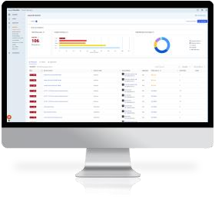





Rapid7 Company Overview
Rapid7 is the missing piece for IBM‘s data-center-focused strategy as it covers the cybersecurity dimension
Rapid7 company overview
Detailed product overview
Rapid7 is the market leader in cybersecurity infrastructure for Cloud
Rapid7 is a cybersecurity company and
the market leader in Cloud protection
InsightVM
Managed Services
Business Segments
Professional Services
Provision of professional services to complement Rapid7’s cybersecurity
product suite
Makes up 4.8% of
Products
Sale of cybersecurity related products for threat detection, incident response, and compliance assessment
Makes up 95% of
InsightIDR
Products
tCell
InsightAppSec
Metasploit
segment revenue
Products
Professional Services
segment revenue
InsightConnect
InsightCloudSec
Financial overview
Rapid7 is currently unprofitable due to high SG&A expenses
Rapid7 offers cybersecurity solutions for digital infrastructure and is the market leader in Cloud cybersecurity with their Cloud Workload Protection Platform and products such as InsightCloudSec and Cloud Risk Complete
+45.3%
Rapid7 is not profitable due to high SG&A, which IBM could reduce
685
778
778
232
535
546
Customer Exposure Geographical Exposure
573
11’000+
Existing broad customer base
Key Market USA
US Revenue
2022
Revenue
_{74.7%}vs 25.3%
2021
2023
-27
EBIT
Revenue
COGS
Gross Profit
SG&A
exports
Source: (Rapid 7, (2024a, 2024b, n.d.))
Executive |  | Market Analysis |  | Strategic Fit |  | Financial |  | Feasibility |  | Alternative |  | Conclusion
Summary |  |  |  |  |  | Analysis |  |  |  | Solution
59

Slide 60


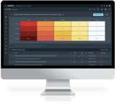
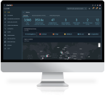
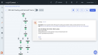
IBM And Rapid7 Strategic Fit
An acquisition would strengthen IBM’s Cloud network security offerings, filling a key gap in the firm‘s cybersecurity portfolio
Comprehensive cloud security offering
SMEs
IBM Cybersecurity
Portfolio
With the acquisition of Rapid7, IBM remedy a crucial gap in its in-house Cloud workload security offering and create productive synergies in hybrid Cloud, network protection, EDR and vulnerability management.
Both IBM and Rapid7 service customers across industries and sizes, however, Rapid7‘s Cloud-native offerings, software-first products and price points are geared more towards SMEs.
Rapid7’s knowledge and expertise in managing cybersecurity for Cloud computing firms, colocation centers, data centers and tech-heavy firms would further allow IBM to offer its products in this growing niche.
Combining the two firm’s product strengths and niche expertise would allow IBM to service rather than operate all parts of the Cloud computing value chain, without the downsides of capital-heavy investments.
Positioning itself well in these markets would enable IBM to capitalize on strong demand growth as SMBs from crucial industries accelerate investments in Cloud cybersecurity.
Rapid7 integration
Product
InsightCloudSec
InsightVM
InsightIDR
InsightConnect
tCell
tCell bolsters IBM’s offerings in web-app security in IBM WebSphere. It’s runtime application self-protection (RASP) and in- app web application firewall (WAF) capabilities could be a value addition to IBM’s Cloud and application security products.
Offering
Fit
Particularly strong in Cloud security posture management (CSPM) and Cloud Workload Protection (CWP),
InsightCloudSec would fill the crucial
weakness in IBM’s Cloud Security Solutions, and compliment IBM Randoori.
InsightVM's ability to assess and remediate across on-premises, Cloud, and virtual infrastructures could dovetail with IBM’s existing tools to provide a more robust end-to-end vulnerability management solution.
Compliments IBM’s SIEM offering by strengthening its Cloud-based analytics and behavior profiling tools in QRadar®. This grants IBM an edge in behavioral analytics and early threat detection.
Rapid7’s security orchestration, automation, and response (SOAR) platform allows IBM to help clients streamline their responses to threats and efficiently manage workflows. It would compliment IBM’s AIOps Insights,
+
InsightOps
Rapid7’s log management and configuration tool complements IBM’s Cloud management solutions, offering IBM clients more options for Cloud visibility and analytics within QRadar®.
Synergy
Potential
InsightCloudSec represents the crown jewel of the Rapid7 acquisition.
Provides a stronger foothold in vulnerability management, especially in Cloud management for IBM
Provides a lightweight alternative to IBM’s existing SIEM & XDR tools, reaching a particular niche of lower-budget customers
Better servicing of SMEs and firms with nascent cybersecurity budgets, allowing for future upselling opportunities.
+
Source:
Cloud
SME
(Solberg, T.L., 2023), (Goldman Sachs, 2023), (IBM 2023a)
Executive |  | Market Analysis |  | Strategic Fit |  | Financial |  | Feasibility |  | Alternative |  | Conclusion
Summary |  |  |  |  |  | Analysis |  |  |  | Solution
60

Slide 61
Stand-Alone DCF Valuation of Rapid7
The stand-alone DCF value of Rapid7 is around $44.6 per share compared to the current price of $54.4
Free cash flow forecasts ($ m)
Enterprise value to equity bridge ($ m)
302
-585
+162m
188
244
3,347
Convertible notes
(738)
Cash 439
135
383
(192)
2,762
82
(95)
56
Stock options
38
Leases (833)
Long-term investments
3
-17
2024E 2025E 2026E 2027E 2028E 2029E
Cash flow forecast assumptions (base case)
2030E
2031E
Revenue growth around 12% driven by customer expansion, cross-
selling, and up-selling
R&D expenses decrease as percentage of revenue and move closer to industry average in line with past years’ trends
SG&A expenses move to industry averages in the terminal year as
already observed in the past years
WACC of 8.34% has been obtained using peer group beta, revenue weighted equity risk premium and current capital structure
Capex at comparably low percentage of revenue as most capex is
reflected in R&D expenses
Negative non-cash working capital due to high deferred revenue
Enterprise Value
Debt & Leases
Cash & Investments
Other Obligations
Equity Value
Base case assumptions indicate a down-side potential of 18.2%
Source:
Executive |  | Market Analysis |  | Strategic Fit |  | Financial |  | Feasibility |  | Alternative |  | Conclusion
Summary |  |  |  |  |  | Analysis |  |  |  | Solution
61

Slide 62
Peer Group Trading Multiples
Rapid7 trades at significantly lower multiples compared to its peer group, indicating high upside potential
Enterprise
Value ($ m)
EV/Sales
LTM-FY24E
EV/EBITDA LTM
EV/EBIT
LTM
4,010
4,7x
5,2x
n.m.
n.m.
5,770
9,5x
30,4x
35,4x
10,4x
Median (FY24E): 9.5x
5,320
5,9x
n.m.
n.m.
6,7x
9,6x
5,210
n.m.
n.m.
10,4x
11,2x
10,380
n.m.
n.m.
13,8x
FY24E LTM
Comparables indicate a significant upside at an average $95 per share compared to a current price of $54.4
Source: (Yahoo Finance, 2024)
Executive |  | Market Analysis |  | Strategic Fit |  | Financial |  | Feasibility |  | Alternative |  | Conclusion
Summary |  |  |  |  |  | Analysis |  |  |  | Solution
62

Slide 63
Valuation of Rapid7 Including Synergies
Rapid7‘s value to IBM is 20% higher than its share price, driven by cross-selling synergies and reductions in SG&A expenses
Revenue synergies, by industry (As % of Target Revenue)
Value per share of Rapid7 Including synergies
Median
37%
+19%
Used median revenue synergy of 8% of Rapid7’s revenue
$64,6
25%
$6,2
$13,8
$54,4
15%
14%
$44,6
10%
8%
8%
4%
6%
6%
2%
4%
3%
1%
3%
C&IP E&R FSI LSHC
Cross-selling synergies additional free cash flow ($ m)
TMT
Cross-Selling Synergies
Stand-Alone
Higher Margin
No additional R&D requirements for cross-selling
48
43
302
38
244
Stand-Alone
Value
Cross-Selling
Synergies
Cost
Synergies
Combined
Value
Current
Price
33
188
28
135
10
3
23
82
Including revenue and cost synergies, Rapid7 is worth 19%
more to IBM than its current share price
-17
19
38
2024E 2025E 2026E 2027E 2028E 2029E 2030E 2031E
Source: (Deloitte, 2022)
Executive Summary
Market Analysis
Strategic Fit
Financial Analysis
Feasibility
Alternative Solution
Conclusion
63

Slide 64


Acquisition Feasibility And Financing Structure
The acquisition of Rapid7 can be financed using IBM’s current cash balance and leads to a win-win situation for IBM and Rapid7 shareholders
Feasibility considerations
The IBM acquisition of Rapid7 appears to be feasible
Financing structure
A cash acquisition is possible and creates value uplift for both sides
Transaction Assumptions
Offer Assumptions | USDm |  | Synergies Net Present Value
Rapid7 Net Debt | 547 |  | Synergy 1 - Cross-Selling | 855
Offer Price Per Share | 70 |  | Synergy 2 - Cost Synergies | 384
Premium 30% |  | Total Synergies, Net |  | 1'240
Offer Value 4'890
Value Creation / (Destruction)
Pro Forma Valuation |  | Pro Forma Enterprise Value |  | 225'395
IBM Enterprise Value 220'267 Pro Forma Net Debt 44'846
Rapid7 Enterprise Value | 3'888 | Pro Forma Equity Value |  | 180'549
Net Present Value of Synergies 1'240 |  |  | Attributable to IBM Shareholders | 100%
Pro Forma Enterprise Value 225'395 |  |  | Attributable to Rapid7 Shareholders | 0%
 |  |  | Additional Cash Consideration | 4'890
IBM Net Debt 44'299
Rapid7 Net Debt 547 |  |  | Value Uplift / (Destruction)
Low to High Risk | Evaluation of Risk Factor Likelihood and Severity | Threat Assessment
Antitrust Regulation | Regulatory intervention is unlikely in this case HHI The cybersecurity HHI ₂₇₈ is well below the 2’500 _{/10’000} threshold at 278
Post- merger integration | IBM has historical competence in integrating smaller tech companies The expected likelihood and severity of integration issues following the Rapid7 acquisition is therefore low
Incremental Debt -
Pro Forma Net Debt 44'846
For IBM Shareholders For Rapid7 Shareholders
2.6%
46.4%
An All-Cash Transaction is Feasible
In line with IBM’s past transactions, the acquisition of Rapid7 can be financed using exclusively cash-on-hand
An all-cash transaction preserves IBM’s credit rating and does not dilute earnings as neither additional debt nor stock is issued
The transaction provides value uplift for both IBM and Rapid7 shareholders!
IBM should acquire Rapid7 given the strong synergies and feasibility of the transaction
Source: Yahoo Finance, 2024)
Executive |  | Market Analysis |  | Strategic Fit |  | Financial |  | Feasibility |  | Alternative |  | Conclusion
Summary |  |  |  |  |  | Analysis |  |  |  | Solution
64

Slide 65




Post-Acquisition Strategy
Integrating Rapid7’s cybersecurity capabilities post-acquisition to establish end-to-end hybrid Cloud leadership requires retaining key talents
Comprehensive secure and end-to-end Hybrid Cloud provider
Post-merger integration strategies
IBM can expand their strategic success position in hybrid Cloud
Post-merger integration must consider talent, technology, and R&D
End-to-end coverage of customer needs in hybrid Cloud
Combining of Rapid7’s Cloud security platform with IBM’s existing hybrid Cloud solutions
1. Workforce Integration and Retention
Openness and
transparency
Off-hand approach to
avoid alienating talent
Monitor attrition rates
closely and proactively
Offer generous stock
options to retain talent
Focus on furthering cultural integration
Continue to support
open source initiatives
IBM can leverage Rapid7’s cybersecurity
expertise to establish hybrid Cloud leadership
2. Technological Integration
Developing Key Cybersecurity Talent is the Main Concern
Integrate Rapid7’s offerings with IBM’s
Enable integrations
between offerings
Align software development
Consolidate code base maintenance
Avoid technical debt
and align architectures
Streamline Cloud user experience for security
Acquiring and integrating Rapid7 allows IBM to strengthen key talent
There is a shortage of cybersecurity workers
perceived at enterprises in the US
3. Streamlining of R&D Efforts
IBM can develop edge over other cloud solution providers by bolstering their cloud security capabilities with a deep talent pool
Consolidate R&D efforts under IBM
Leverage IBM research facilities for Rapid7
Avoid redundancies
in research efforts
Communicate ongoing research projects
Adopt a structured approach to R&D
Integrate Rapid7’s methods with IBM’s
Too Many Don’t Know
Right Too Few
Source: (Help Net Security, 2017)
Executive |  | Market Analysis |  | Strategic Fit |  | Financial |  | Feasibility |  | Alternative |  | Conclusion
Summary |  |  |  |  |  | Analysis |  |  |  | Solution
65

Slide 66
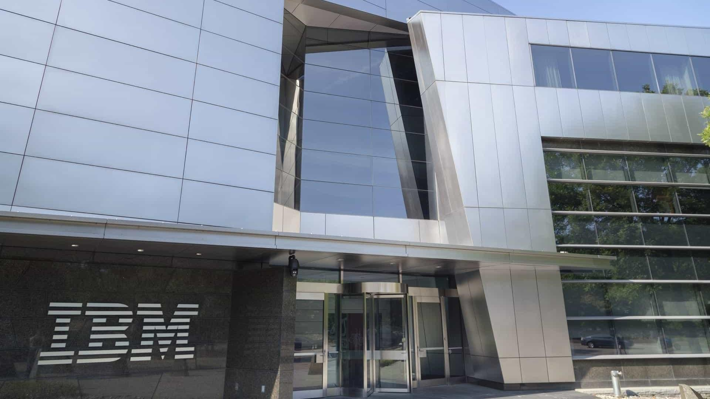
CONCLUSION
Back to the Future

Slide 67



Conclusion
IBM should focus on their strenght and postition itself as a leader in cybersecurity
A Future Among the (IBM) Clouds
Too Big to Acquire
Computing will continue to shift towards the Cloud and Edge solutions, providing the foundation for technologies such as AI and IoT services
This will drive immense productivity gains and a boost to productive processes across industries
Acquiring Equinix would allow IBM to operate across the
Cloud computing supply chain
Yet, the acquisition would be expensive, uncharacteristic, and yield minimal to negligible synergies in the face of the capital required, destroying value for IBM shareholders
The Centennial Rocketship
Reaching Cloud Nine
IBM is committed to becoming the one-stop-shop for enterprise digitalization needs across its financing, consulting, software and infra. divisions
It is crucial IBM capitalizes upon the continued Cloud transformation, especially as dependent technologies gain traction
Instead, Rapid7 represents the ideal acquisition target, strengthening IBM’s core Cybersecurity offering in Cloud, Networking, and for SMEs
The resulting synergies would solidify IBMs position as the leading servicing firm across the entire Cloud Cybersecurity value chain, increasing IBM shareholder value by 2.6%
Source:
Executive |  | Market Analysis |  | Strategic Fit |  | Financial |  | Feasibility |  | Alternative |  | Conclusion
Summary |  |  |  |  |  | Analysis |  |  |  | Solution
67

Slide 68

BIBLIOGRAPHY
Where We Took Inspiration

Slide 69
Bibliography
Antino (2024). Top IoT Trends in 2023 and What IoT Holds for the Future? [online] Available at: https://www.antino.com/blog/top-9-iot-trends [Accessed 28 Feb. 2024].
Baker, L. and Young, S. (2015). Equinix to buy TelecityGroup for $3.6 billion, Interxion deal ended. Reuters. [online] Available at: https://www.reuters.com/article/idUSKBN0OE0GS/ [Accessed 25 Feb. 2024].
Blackstone. (2021). QTS Realty Trust to Be Acquired by Blackstone Funds in $10 Billion Transaction. [online] Available at: https://www.blackstone.com/news/press/qts-realty-trust-to-be-acquired-by-blackstone-funds-in-10-billion-transaction/ [Accessed 29 Feb. 2024].
Charles, A. (2023). Top 10 Emerging Cloud Computing Trends To Watch In 2023. [online] Koenig-solutions.com. Available at: https://www.koenig-solutions.com/blog/cloud-computing-trends [Accessed 28 Feb. 2024].
Check Point Research (2023). The Tipping Point: Exploring the Surge in IoT Cyberattacks Globally. [online] Check Point Blog. Available at: https://blog.checkpoint.com/security/the-tipping-point-exploring-the-surge-in-iot-cyberattacks-plaguing-the-education-sector/ [Accessed 28 Feb. 2024].
ComputerWeekly.de. (2024). IoT-Trends für 2024 und darüber hinaus | Computer Weekly. [online] Available at: https://www.computerweekly.com/de/meinung/IoT-Trends-fuer-2023-und-darueber-hinaus [Accessed 10 Mar. 2024].
Consultancy.asia (2023). IBM Consulting launches Japan Innovation Hub in the Philippines. [online] Available at: https://www.consultancy.asia/news/5143/ibm-consulting-launches-japan-innovation-hub-in-the-philippines [Accessed 10 Mar. 2024].
Cybersecurity - Worldwide. Accessed: March 10, 2024. https://www.statista.com/outlook/tmo/cybersecurity/worldwide [Accessed 28 Feb. 2024].
Cybersecurity Insiders (2023). Cloud Security Report. Available at: https://www.isc2.org/-/media/Project/ISC2/Main/Media/Marketing-Assets/CCSP/2023-Cloud-Security-Report-ISC2_final.pdf?rev=85380384b4e248148e14684d8e43375a&hash=27B496154D2B8AF3AEEE725D1BEF3 92F.
Damodaran. (2024). Country Default Spreads and Risk Premiums. [online] Available at: https://pages.stern.nyu.edu/~adamodar/ [Accessed 21 Feb. 2024].
Data Centre Dynamics. (2023). Brookfield and DigitalBridge duke it out to acquire Compass Datacenters. [online] Available at: https://www.datacenterdynamics.com/en/news/brookfield-and-digitalbridge-duke-it-out-to-acquire-compass-datacenters/ [Accessed 25 Feb. 2024].
Deep Instinct. (2023). Infographic: Voice of SecOps (4th Edition) - Generative AI is Increasing in Cyber Attacks. [online] Available at: https://www.deepinstinct.com/pdf/infographic-voice-of-secops-4th-edition-generative-ai-in-cyber.
Deloitte. (2022). Unlocking the full potential of M&A. [online] Available at: https://www2.deloitte.com/content/dam/Deloitte/ch/Documents/mergers-acqisitions/ch-en-fa-st-gallen-mergers-acquisitions-study-v2.pdf [Accessed 07 Mar. 2024].
Drapkin, A. (2023). 29 Key Artificial Intelligence (AI) Statistics to know in 2023. [online] Tech.co. Available at: https://tech.co/news/ai-statistics-and-trends [Accessed 29 Feb. 2024].
Duarte, F. (2023). Amount of data created daily (2023). [online] Exploding Topics. Available at: https://explodingtopics.com/blog/data-generated-per-day [Accessed 26 Feb. 2024]
Equinix (2024). Data Centers. [online] Available at: https://www.equinix.com/data-centers#tab-2 [Accessed 26 Feb. 2024].
McKinsey (2021) Cloud’s trillion-dollar prize is up for grabs. https://www.mckinsey.com/capabilities/mckinsey-digital/our-insights/clouds-trillion-dollar-prize-is-up-for-grabs [Accessed 01 Mar. 2024]
Grimond, L., Beyer, M. and Maguire, A. (2023). Cloud Computing: A Boardroom View. [online] Available at: https://web-assets.bcg.com/59/6e/b413265a492fb65579843b0122b3/bcg-cloud-computing-a-boardroom-view-final.pdf [Accessed 10 Mar. 2024].
Exploding Topics. (2022). 7 Cloud Computing Trends (2023-2028). [online] Available at: https://explodingtopics.com/blog/cloud-computing-trends [Accessed 26 Feb. 2024].
Finro Financial Consulting. (2023). AI Startups: Valuations and Multiples 2024. [online] Available at: https://finrofca.com/news/ai-startups-valuations-and-multiples-2024 [Accessed 10 Mar. 2024].
FitchRatings. (2024). Equinix, Inc. [online] Available at: https://www.fitchratings.com/entity/equinix-inc-82742345 [Accessed 24 Feb. 2024].
Fortune Business Insights (2023). Infrastructure as a Service [IaaS] Market Share & Growth, 2030. [online] Available at: https://www.fortunebusinessinsights.com/infrastructure-as-a-service-iaas-market-107351 [Accessed 23 Oct. 2023].
Gartner (2023). Gartner Places Generative AI on the Peak of Inflated Expectations on the 2023 Hype Cycle for Emerging Technologies. [online] Gartner. Available at: https://www.gartner.com/en/newsroom/press-releases/2023-08-16-gartner-places-generative-ai-on-the-peak-of-inflated- expectations-on-the-2023-hype-cycle-for-emerging-technologies [Accessed 26 Feb. 2024].
Gartner (2022), Magic Quadrant for Network Firewalls [online] Gartner. Available at: https://www.gartner.com/doc/reprints?id=1-2C1K77PM&ct=221219&st=sb?utm_source=marketo&utm_medium=email&utm_campaign=Global-DA-EN-22-12-07-7014u000001tGHKAA2-P3-
Security_Networks-gartner-mq-for-firewalls
Source:
Executive |  | Market Analysis |  | Strategic Fit |  | Financial |  | Feasibility |  | Alternative |  | Conclusion
Summary |  |  |  |  |  | Analysis |  |  |  | Solution
69

Slide 70
Bibliography
Gianni, P. and Maria, G. (2021). Handbook of Research on Teaching With Virtual Environments and AI. [online] Google Books. IGI Global. Available at:
https://books.google.ch/books?hl=de&lr=&id=bxkfEAAAQBAJ&oi=fnd&pg=PR1&dq=handbook+of+research+on+teaching+with+virtual+environments+and+ai&ots=ejjv-X4Chs&sig=M_LufbhDggMj8cRzEfV Ij-5_8#v=onepage&q=95%25&f=false [Accessed 10 Mar. 2024].
GlobalData Plc (2022). Global: Top Cybersecurity Patents Holders (2002 - 2022). [online] Globaldata.com. Available at: https://www.globaldata.com/data-insights/macroeconomic/global-top-cybersecurity-patents-holders-in-the--sector-
2131431/#:~:text=The%20top%20five%20patent%20holders [Accessed 10 Mar. 2024].
Goldman Sachs (2023). AI investment forecast to approach $200 billion globally by 2025. [online] Goldman Sachs. Available at: https://www.goldmansachs.com/intelligence/pages/ai-investment-forecast-to-approach-200-billion-globally-by-2025.html.
Gregg, A. (2023). Dupont Fabros merges with Digital Realty, creating a data center giant. Washington Post. [online]. Available at: https://www.washingtonpost.com/business/capitalbusiness/dupont-fabros-merges-with-digital-reality-creating-a-data-center-giant/2017/06/09/2a71d328-4d37-
11e7-bc1b-fddbd8359dee_story.html [Accessed 29 Feb. 2024].
Grimond, L., Beyer, M. and Maguire, A. (2023). Cloud Computing: A Boardroom View. [online] Available at: https://web-assets.bcg.com/59/6e/b413265a492fb65579843b0122b3/bcg-cloud-computing-a-boardroom-view-final.pdf [Accessed 10 Mar. 2024].
Hammond, E. and Tan, G. (2021). American Tower Nears $10 Billion Deal to Buy CoreSite. Bloomberg. [online] Available at: https://www.bloomberg.com/news/articles/2021-11-14/american-tower-said-to-near-10-billion-deal-to-buy-coresite [Accessed 29 Feb. 2024].
Hao, K. (2019). Training a single AI model can emit as much carbon as five cars in their lifetimes. [online] MIT Technology Review. Available at: https://www.technologyreview.com/2019/06/06/239031/training-a-single-ai-model-can-emit-as-much-carbon-as-five-cars-in-their-lifetimes/.
Help Net Security(2017). Keys to attracting and retaining cybersecurity talent. [online] Help Net Security. Available at: https://www.helpnetsecurity.com/2017/05/11/retaining-cybersecurity-talent/ [Accessed 10 Mar. 2024].
Hindustan Times. (2023). IBM says expansion in India’s emerging clusters to build professional pools. [online] Available at: https://www.hindustantimes.com/technology/ibm-says-expansion-in-indias-emerging-clusters-to-build-professional-pools-101694575898780.html [Accessed 10 Mar. 2024].
IBM. (2017). The importance of securing data in the cloud. [online] The importance of securing data in the cloud. Available at: https://www.ibm.com/cloud/smartpapers/securing-data-in-the-cloud/.
IBM. (2020). IBM Products. [online] Available at: https://www.ibm.com/products?types [Accessed 25 Feb. 2024].
IBM. (2023a). Cost of a data breach 2023. [online] IBM. Available at: https://www.ibm.com/reports/data-breach [Accessed 25 Feb. 2024].
IBM. (2023b). IBM Strategic Partnerships | IBM. [online] www.ibm.com. Available at: https://www.ibm.com/strategic-partnerships [Accessed 25 Feb. 2024].
IBM. (2024a). Form 10-K 2023 Annual Report Report.Available at: https://www.sec.gov/ixviewer-plus/ix.xhtml?doc=/Archives/edgar/data/51143/000005114324000012/ibm-20231231.html [Accessed 25 Feb. 2024].
IBM. (2024b). Maple Leaf Sports & Entertainment Ltd. (MLSE) | IBM. [online] Available at: https://www.ibm.com/case-studies/maple-leaf-sports-and-entertainment [Accessed 10 Mar. 2024].
IBM. (n.d.a). IBM Security Products. [online] Available at: https://www.ibm.com/security/products [Accessed 25 Feb. 2024].
IBM. (n.d.b). What is the internet of things? | IBM. [online] Available at: https://www.ibm.com/topics/internet-of-things#:~:text=The%20Internet%20of%20Things%20(IoT)%20refers%20to%20a%20network%20of [Accessed 28 Feb. 2024].
IBM. (n.d.c). IBM Cloud Global Data Centers. [online] Available at: https://www.ibm.com/cloud/data-centers [Accessed 28 Feb. 2024].
IBM. (n.d.d). IBM Cloud Global Data Centers. [online] Available at: https://www.ibm.com/cloud/data-centers [Accessed 01 Mar. 2024].
IBM Newsroom. (2021). IBM Completes the Separation of Kyndryl. [online] Available at: https://newsroom.ibm.com/2021-11-03-IBM-Completes-the-Separation-of-Kyndryl [Accessed 28 Feb. 2024].
IBM Newsroom (2023a). Krungthai Bank and IBM establish joint venture to drive sustainable growth in traditional banking business. [online] Available at: https://asean.newsroom.ibm.com/Krungthai-Bank-and-IBM-establish-joint-venture [Accessed 10 Mar. 2024].
IBM Newsroom. (2023b). IBM Launches $500 Million Enterprise AI Venture Fund. [online] Available at: https://newsroom.ibm.com/2023-11-07-IBM-Launches-500-Million-Enterprise-AI-Venture-Fund [Accessed 28 Feb. 2024].
IBM Newsroom. (2023c). IBM to acquire Equine Global to expand consulting capabilities in Indonesia. [online] Available at: https://newsroom.ibm.com/IBM-to-acquire-Equine-Global-to-expand-consulting-capabilities-in-Indonesia [Accessed 10 Mar. 2024].
IBM Newsroom. (2023d). IBM to Acquire StreamSets and webMethods Platforms from Software AG. [online] Available at: https://newsroom.ibm.com/2023-12-18-IBM-to-Acquire-StreamSets-and-webMethods-Platforms-from-Software-AG [Accessed 28 Feb. 2024].
Source:
Executive |  | Market Analysis |  | Strategic Fit |  | Financial |  | Feasibility |  | Alternative |  | Conclusion
Summary |  |  |  |  |  | Analysis |  |  |  | Solution
70

Slide 71
Bibliography
IBM Newsroom. (2023e). IBM Unveils the Watsonx Platform to Power Next-Generation Foundation Models for Business. [online] Available at: https://newsroom.ibm.com/2023-05-09-IBM-Unveils-the-Watsonx-Platform-to-Power-Next-Generation-Foundation-Models-for-Business [Accessed
28 Feb. 2024].
Josh Mahan. (2023). Understanding Data Center Energy Consumption - C&C Technology Group. [online] Available at: https://cc-techgroup.com/data-center-energy-consumption/#:~:text=this%20work%20efficiently.
KKR. (2021). Available at: https://media.kkr.com/rss-feed/news-release/?news_id=6f0b8be1-2767-4e42-ad91-23b9d45f9126&type=1 [Accessed 25 Feb. 2024].
Kolesnikov, N. (2023). 65 + Cloud Computing Statistics You Need to Know For August 2023 – The Where, Why & How Much. [online] Techopedia. Available at: https://www.techopedia.com/cloud-computing-statistics [Accessed 10 Mar. 2024].
Krewell, K. (2022). The Next Generation Of IBM Quantum Computers. [online] Forbes. Available at: https://www.forbes.com/sites/tiriasres earch/2022/06/22/the-next-generation-of-ibm-quantum-computers/ [Accessed 10 Mar. 2024].
Lambert Consulting (2023). Statistics and trends in Cloud Computing 2023 - 2024. [online] Lambert Consulting SA. Available at: https://www.lambertconsulting.ch/en/statistiques-et-tendances-du-cloud-computing-2023-2024/ [Accessed 10 Mar. 2024].
Lindner, O. (2020). Hybrid Digital Infrastructure Management for Edge Data Centers. [online] FNT Software Blog. Available at: https://fntsoftware.com/blog/industry-expertise-hybrid-digital-infrastructure-management-for-edge-data-centers/ [Accessed 10 Mar. 2024].
Little., A. (2019). Digital infrastructure as a driver of competitiveness. [online] Available at: https://www.adlittle.com/en/insights/report/digital-infrastructure-driver-competitiveness [Accessed 10 Mar. 2024].
Macquarie. (2021). Could digital infrastructure be the next sustainable investment opportunity? | Macquarie Group. [online] Available at: https://www.macquarie.com/au/en/insights/digital-infrastructure-as-a-sustainable-investment-opportunity-for-the-future.html [Accessed 10 Mar. 2024].
MarketsandMarkets. (2023). Hyperscale Computing Market Size, Statistics, Growth Analysis & Trends [2030]. [online] Available at: https://www.marketsandmarkets.com/Market-Reports/hyperscale-computing-market-77118278.html [Accessed 10 Mar. 2024].
Minnix, J. (2023). 105 Data Center Stats You Should Know In 2024. [online] Brightlio - Technology Iluminated. Available at: https://brightlio.com/data-center-stats/ [Accessed 01 Mar. 2024].
Mok, A. (2023). More than half of tech workers think AI is overrated, study finds. [online] Business Insider. Available at: https://businessinsider.com/tech-workers-say-ai-is-overrated-study-finds-2023-11 [Accessed 10 Mar. 2024].
Nathan, A., Grimberg, J., Rhodes, A. (2023). " " TOP MIND. [online] Available at: https://www.goldmansachs.com/intelligence/pages/top-of-mind/generative-ai-hype-or-truly-transformative/report.pdf [Accessed 01 Mar. 2024].
Nelson, M. (2021). Creating sustainable digital infrastructure. [online] Digital Infra Network. Available at: https://digitalinfranetwork.com/creating-sustainable-digital-infrastructure/ [Accessed 10 Mar. 2024]
Panchal, P. (2022). Benchmark Shows Performance Benefits of Equinix Fabric for Cloud Data. [online] Interconnections - The Equinix Blog. Available at: https://blog.equinix.com/blog/2022/10/17/benchmark-shows-performance-benefits-of-equinix-fabric-for-cloud-data/ [Accessed 10 Mar. 2024].
Petrosyan, A. (2024). Cost of a data breach in the U.S. 2023. [online] Statista. Available at: https://www.statista.com/statistics/273575/us-average-cost-incurred-by-a-data-breach/#:~:text=As%20of%202023%2C%20the%20average [Accessed 01 Mar. 2024].
Precedence Research (2023). Hyperscale Data Center Market Size, Trends, Growth, Report 2032. [online] Available at: https://www.precedenceresearch.com/hyperscale-data-center-market.
Rapid7 (2024) 10-k Annual report 2023. [online] Available at: https://www.sec.gov/ixviewer/ix.html?doc=/Archives/edgar/data/0001560327/000156032724000021/rp-20231231.htm
Rapid7. (2024) Investor deck Q4’23 Earnings. Available at: https://s29.q4cdn.com/157304370/files/doc_financials/2023/q4/Inves tor-Deck-Q4-23-Earnings-FINAL.pdf [Accessed 10 Mar. 2024].
Rapid7. (n.d.). Accelerate Security, Vuln Management, Compliance. [online] Available at: https://www.rapid7.com/ [Accessed 10 Mar. 2024].
Red Hat. (2023). Red Hat Named a Leader in 2023 Gartner® Magic QuadrantTM for Container Management. [online] Available at: https://www.redhat.com/en/blog /red-hat-named-leader-2023-gartnerr-magic-quadranttm-container-management [Accessed 10 Mar. 2024].
Roshan, D. (2019). Digital Realty to buy InterXion in $8.4 billion deal. Reuters. [online] Available at: https://www.reuters.com/article/us-interxion-hldg-m-a-digital-realty-idUSKBN1X82GY/ [Accessed 25 Feb. 2024].
Sen, A. (2022). DigitalBridge buys data center company Switch for $11 billion. Reuters. [online]. Available at: https://www.reuters.com/technology/switch-be-taken-private-by-digitalbridge-11-bln-deal-2022-05-11/ [Accessed 25 Feb. 2024].
SES (2018). SES Networks Enables Direct Connectivity to IBM Cloud via Global Satellite Network | SES. [online] Available at: https://www.ses.com/press-release/ses-networks-enables-direct-connectivity-ibm-cloud-global-satellite-network [Accessed 10 Mar. 2024].
Solberg, T.L. (2023). 7 Charts On the AI Stock Boom One Year After ChatGPT’s Launch. [online] Morningstar UK. Available at: https://www.morningstar.co.uk/uk/news/243676/7-charts-on-the-ai-stock-boom-one-year-after-chatgpts-launch.aspx [Accessed 10 Mar. 2024].
Statista (2022). Software - Worldwide | Statista Market Forecast. [online] Statista. Available at: https://www.statista.com/outlook/tmo/software/worldwide [Accessed 26 Feb. 2024].
Sourc
e:
Executive |  | Market Analysis |  | Strategic Fit |  | Financial |  | Feasibility |  | Alternative |  | Conclusion
Summary |  |  |  |  |  | Analysis |  |  |  | Solution
71

Slide 72
Bibliography
Statista. (2023a). Global cloud infrastructure services spending 2022. [online] Available at: https://www.statista.com/statistics/967292/worldwide-cloud-infrastructure-services-market-revenue/ [Accessed 25 Feb. 2024].
Statista. (2023b). IoT connected devices by vertical 2030. [online] Available at: https://www.statista.com/statistics/1194682/iot-connected-devices-vertically/ [Accessed 25 Feb. 2024].
Statista. (2023c). Top 10 cloud vendors by revenue worldwide 2021. [online] Available at: https://www.statista.com/statistics/1243513/top-10-cloud-vendors-by-revenue-fiscal-quarter-global/ [Accessed 25 Feb. 2024].
Statista. (2023d). Global datacenter colocation market revenue 2014-2023 | Statista. [online] Available at: https://www.statista.com/statistics/496373/datacenter-colocation-revenue-worldwide/ [Accessed 25 Feb. 2024].
Statista. (2023e). Data Center - Worldwide | Statista Market Forecast. [online] Available at: https://www.statista.com/outlook/tmo/data-center/worldwide [Accessed 25 Feb. 2024].
Statista. (2023f). Public Cloud - Worldwide | Statista Market Forecast. [online] Available at: https://www.statista.com/outlook/tmo/public-cloud/worldwide#revenue [Accessed 25 Feb. 2024].
Statista. (2024a). Generative AI market size worldwide 2030. [online] Available at: https://www.statista.com/forecasts/1449838/generative-ai-market-size-worldwide.
Statista. (2024b). SaaS market size worldwide 2024. [online] Available at: https://www.statista.com/statistics/505243/worldwide-software-as-a-service-revenue/#:~:text=In%202023%2C%20the%20software%20as [Accessed 10 Mar. 2024].
Statista. (2024c). World: Generative AI market growth 2030. [online] Available at: https://www.statista.com/forecasts/1449870/generative-ai-market-growth-
global#:~:text=Growth%20of%20the%20generative%20AI%20market%20globally%20from%202021%2D2030&text=The%20generative%20AI%20market%20is [Accessed 10 Mar. 2024].
Statista. (n.d.a). Valuation of AI vs. non-AI startups by stage 2023. [online] Available at: https://www.statista.com/statistics/1446293/median-valuations-ai-startups-by-stage/ [Accessed 10 Mar. 2024].
Statista. (n.d.b). Worldwide AI tool users 2030. [online] Available at: https://www.statista.com/forecasts/1449844/ai-tool-usersworldwide#:~:text=AI%20tool%20user%20numbers%20worldwide%20from%202020%2D2030&text=People%20using%20AI%20tools%20globally - [Accessed 10 Mar. 2024].
Stratton, J. (2022). 3 Key Components of High Performing Data Center Operations. [online] Interconnections - The Equinix Blog. Available at: https://blog.equinix.com/blog/2022/04/28/3-key-components-of-high-performing-data-center-operations/ [Accessed 10 Mar. 2024].
Synergy Research Group. (2022). Equinix, Digital Realty and NTT Control 30% of the Growing Worldwide Colocation Market | Synergy Research Group. [online] Available at: https://www.srgresearch.com/articles/equinix-digital-realty-and-ntt-control-30-of-the-growing-worldwide-colocation- market [Accessed 10 Mar. 2024].
Synergy Research Group. (2023). Private Equity Totally Dominated 2022 Data Center M&A Deals, Breaking All Previous Records | Synergy Research Group. [online] Available at: https://www.srgresearch.com/articles/private-equity-totally-dominated-2022-data-center-ma-deals-breaking-all-
previous-records [Accessed 25 Feb. 2024].
The Business Research Company. (2024). Platform as a service (PaaS) Market Size, Share Analysis, Forecast To 2024-2033. [online] Available at: https://www.thebusinessresearchcompany.com/report/platform-as-a-service-global-market-
report#:~:text=The%20platform%20as%20a%20service%20(paas)%20market%20size%20has%20grown [Accessed 10 Mar. 2024].
Thompson, A. (2015). IBM’s Generic Strategy, SWOT Analysis & Strategic Choices. [online] Panmore Institute. Available at: https://panmore.com/ibm-strategic-choices-strategic-management#:~:text=At%20IBM%2C%20strategic%20choices%20of.
Thormundsson, B. (2023). Artificial Intelligence Market Size 2030. [online] Statista. Available at: https://www.statista.com/statistics/1365145/artificial-intelligence-market-size/.
Trading Economics. (2019). United States Government Bond 10Y | 2019 | Data | Chart | Calendar. [online] Tradingeconomics.com. Available at: https://tradingeconomics.com/united-states/government-bond-yield [Accessed 21 Feb. 2024].
Vardhman, J. (2024). 15 Crucial Data Center Statistics to Know in 2023. [online] Available at: https://techjury.net/blog/data-center-statistics/.
Yahoo Finance. (2023a). [Latest] Global Digital Infrastructure Market Size/Share Worth USD 1000.52 Billion by 2032 at a 23.60% CAGR: Custom Market Insights (Analysis, Outlook, Leaders, Report, Trends, Forecast, Segmentation, Growth, Growth Rate, Value). [online] Available at: https://finance.yahoo.com/news/latest-global-digital-infrastructure-market-103000574.html [Accessed 29 Feb. 2024].
Zhang, M. (2022). How Much Does it Cost to Build a Data Center? [online] Dgtl Infra. Available at: https://dgtlinfra.com/how-much-does-it-cost-to-build-a-data-center/ [Accessed 26 Feb. 2024].
Source:
Executive |  | Market Analysis |  | Strategic Fit |  | Financial |  | Feasibility |  | Alternative |  | Conclusion
Summary |  |  |  |  |  | Analysis |  |  |  | Solution
72

Slide 73
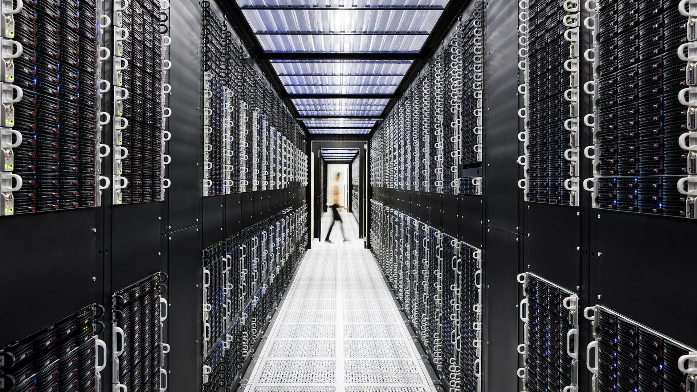
APPENDIX
A Look Inside

Slide 74
IBM x Equinix Acquisition Model
Company Financials |  |  |  |  |  | Accretion Dilution Analysis
IBM Financial Profile | USDm |  | Equinix Financial Profile | USDm |  | IBM Standalone |  |  | Equinix Standalone
NOSH | 917 |  | NOSH | 94 |  | Standalone EBIT | 9'057 |  | Standalone EBIT | 1'443
Share Price | 192 |  | Share Price | 856 |  | Interest Expense | 1'607 |  | Interest Expense | 319
Market Cap | 175'968 |  | Market Cap | 80'383 |  | % Tax Rate | 17.1% |  | % Tax Rate 13.8%
FY25 EPS Est. P/E | 11 18.0x |  | FY25 EPS Est. P/E | 14 62.2x |  | IBM Standalone Net Income | 7'502 |  | Equinix Standalone Net Income 969
Gross Debt | 57'367 |  | Gross Debt | 17'568 |  | Pro Forma Financials |  |  | Pro Forma EPS
Cash & Cash Equivalents | 13'068 |  | Cash & Cash Equivalents | 2'096 |  | Consolidated EBIT | 10'500 |  | Pre-Deal IBM NOSH 917
Net Debt | 44'299 |  | Net Debt | 15'472 |  | Consolidated Net Income | 8'471 |  | Additional Share Issuance 337
Enterprise Value | 220'267 |  | Enterprise Value | 95'855 |  | Long-term Synergies | 819 |  | Pro Forma Diluted Shares 1'254
 |  |  |  |  |  | Pro Forma Adjusted EBIT | 11'319
Transaction Assumptions |  |  |  |  |  | Interest Expense | 3'850 |  | Pro Forma Net Income 6'195
 |  |  |  |  |  | Pro Forma Adjusted EBT | 7'469 |  | Pro Forma EPS 4.9
Offer Assumptions | USDm |  | Financing |  |  | % Tax Rate | 17.1% |  | IBM EPS Pre-Acquisition 11
Equinix Net Debt | 15'472 |  | %Cash | 40% |  | Pro Forma Net Income | 6'195 |  | % Accretion / (Dilution) (53.8%)
Offer Price Per Share | 985 |  | from Balance Sheet | 10%
Premium | 15% |  | from Incremental Debt | 30% |  | Value Creation / (Destruction)
Offer Value | 107'912 |  | %Stock | 60%
 |  |  |  |  |  | Pro Forma Valuation |  |  | Pro Forma Enterprise Value 328'308
Cash Consideration |  |  | Synergies Net Present Value |  |  | IBM Enterprise Value | 220'267 |  | Pro Forma Net Debt 92'145
Offer value | 107'912 |  | Synergy 1 - Cross-selling | 4'253 |  | Equinix Enterprise Value | 95'855 |  | Pro Forma Equity Value 236'164
Cash from Balance Sheet | 10'791 |  | Synergy 2 - Cost reduction | 7'489 |  | Net Present Value of Synergies | 12'186 |  | Attributable to IBM Shareholders 73%
Incremental Debt | 32'374 |  | Synergy 3 - Bargaining power Total Synergies, Net | 444 12'186 |  | Pro Forma Enterprise Value | 328'308 |  | Attributable to Equinix Shareholde 27% Additional Cash Consideration 43'165
Stock Consideration |  |  |  |  |  | IBM Net Debt | 44'299
Offer value | 107'912 |  | Fees |  |  | Equinix Net Debt | 15'472 |  | Value Uplift / (Destruction)
Stock Consideration | 64'747 |  | Transaction fees | 2'158.25 |  | Incremental Debt | 32'374 |  | For IBM Shareholders (1.9%)
Additional IBM Shares Issued | 337 |  | % of offer value | 2.0% |  | Pro Forma Net Debt | 92'145 |  | For Equinix Shareholders 32.7%
The Equinix acquisition would be value destructive to IBM Sharehodlers and EPS dilutive
Source: An acquisition of Equinix by IBM would destroy shareholder value for IBM and be heavily EPS dilutive due to how overvalued Equinix is
Appendix
74

Slide 75
Equinix’s Cost Of Capital And IBM’s Debt Schedule
Equinix has a low WACC of 5.91% given a low beta from predictable cash flows and the acquisition
Equity Risk Premium
Cost of Capital
Cost of Capital Of Selected Peer Companies (in USD)
Europe: 35% of sales, equity risk premium grew to around 5.8%, reflecting comparably low risks
Risk-Free Rate r_{f}:
10-year US government bonds
4.3%
20,8%
Equity Risk Premium:
See left-side calculation
5.30%
5,9%
6,4%
6,2%
7,6%
North America: Revenue share of 44%. Risk premium of 4.5%
Levered Beta:
See left-side calculation
0.34
Equinix
GDS Holdings Limited
Digital Keppel DC REIT NEXTDC Limited Realty Trust
Asia: Revenue share of 21%. Risk premium of 6.18% reflects comparably higher risks
Equinix has the lowest cost of capital due to its conservative financing
Equity risk premiums are comparable across selected peer companies
Cost of Equity:
Based on CAPM
6.12%
IBM Credit Rating Impact of Equinix Acquisition
Equity Risk Premium: 5.3%
Credit Default Spread: 1.47% Based on actual rating
 | Debt Schedule and Credit Risk Rating Impact
 | Synthetic Credit Rating Conversion |  | Debt Schedule | USDm
 | Interest coverage to credit rating / spread > ≤ to Rating is Spread is |  | Incremental Debt Borrowing Term IBM Credit Risk | 32'374 20 Years A3/A-
Rating And Levered Beta
Pre-Tax Cost of Debt:
5.8%
r + credit default spread
f
Debt Rating: Credit rating of BBB+ yields an
average credit spread of 1.47%
Tax Rate: 14.5%
Tax rate adjusted for REIT taxation
After-Tax Cost of Debt: 5.77%
Pre-tax cost of debt * (1-T)
0.20
D2/D
20.0%
Spread
1.2%
0.20 | 0.65 | C2/C | 17.0% | 20Y US Treasury Yield 4.4%
0.65 | 0.80 | Ca2/CC | 11.8% | Annual Interest Expense | 1'816
0.80 | 1.25 | Caa/CCC | 8.5%
1.25 | 1.50 | B3/B- | 5.2% | IBM Pre-Acquisition Credit Rating
1.50 | 1.75 | B2/B | 3.6% | EBIT | 9'057
1.75 | 2.00 | B1/B+ | 3.1% | Interest Expense | 1'607
2.00 | 2.25 | Ba2/BB | 2.2% | Interest Coverage | 5.6x
2.25 | 2.50 | Ba1/BB+ | 1.7% | Credit rating | A3/A-
2.50 | 3.00 | Baa2/BBB | 1.5%
3.00 | 4.25 | A3/A- | 1.2% | IBM Post-Acquisition Credit Rating
4.25 | 5.50 | A2/A | 1.1% | EBIT | 11'319
5.50 | 6.50 | A1/A+ | 0.9% | Interest Expense | 3'850
6.50 | 8.50 | Aa2/AA | 0.7% | Interest Coverage | 2.9x
8.50 |  | Aaa/AAA | 0.6% | Credit rating | Baa2/BBB
Unlevered Beta: Median peer company
unlevered beta of 0.3
Debt-to-Equity Ratio: Target of 21.9%
Debt-to-Capital Ratio 17.9%
No change in leverage expected
Tax Rate: Rate of 14.5% reflects REITs benefits
Pre-Tax Cost of Debt: 5.8%
WACC: 5.91%
Source:
Appendix
75

